Slide 1
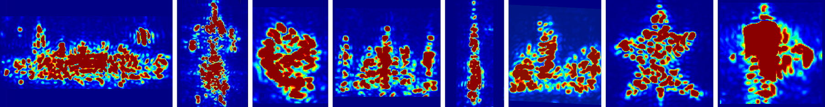



Around-the-Corner mmWave Imaging in Practical Environments
Laura Dodds, Hailan Shanbhag, Junfeng Guan, Saurabh Gupta, Haitham Hassanieh

Slide 2
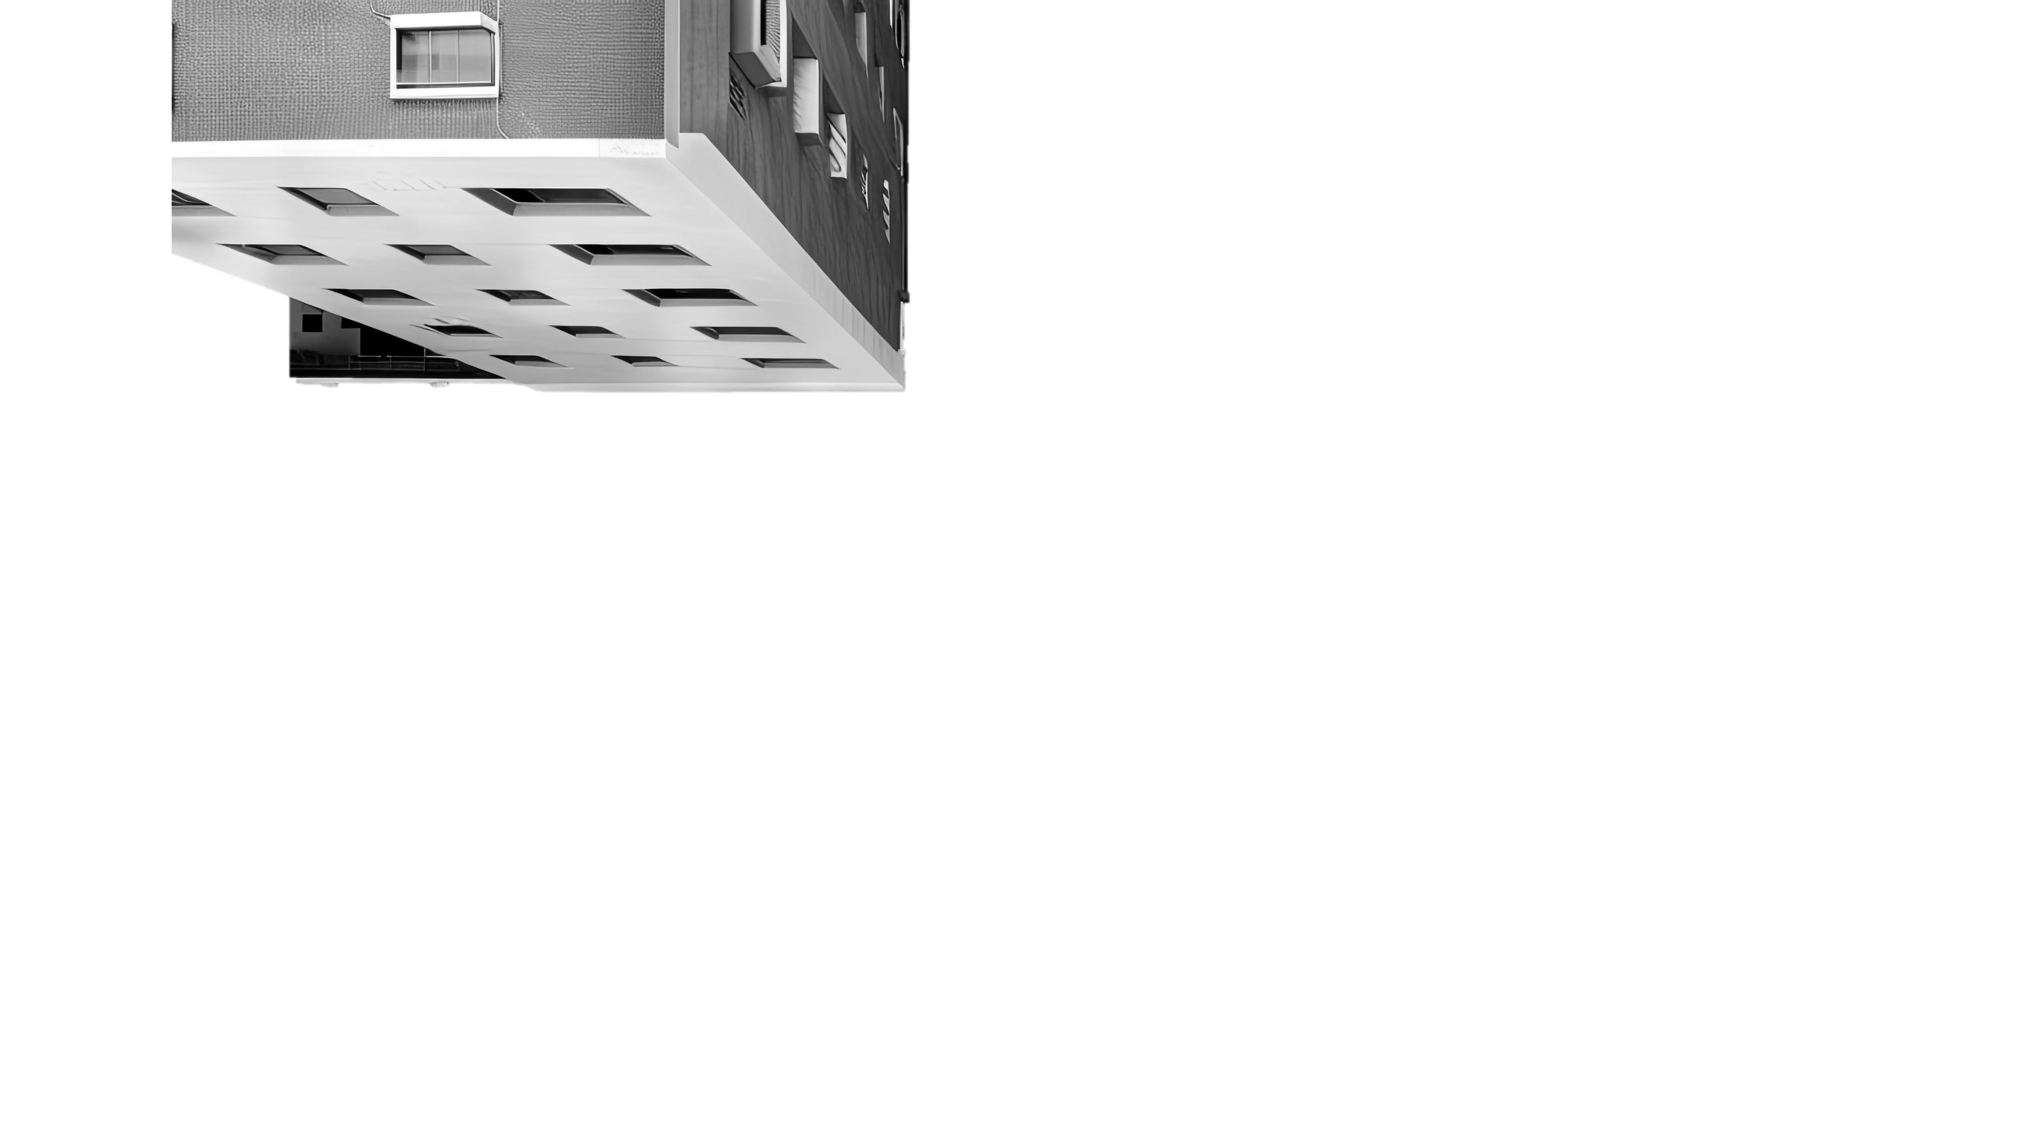
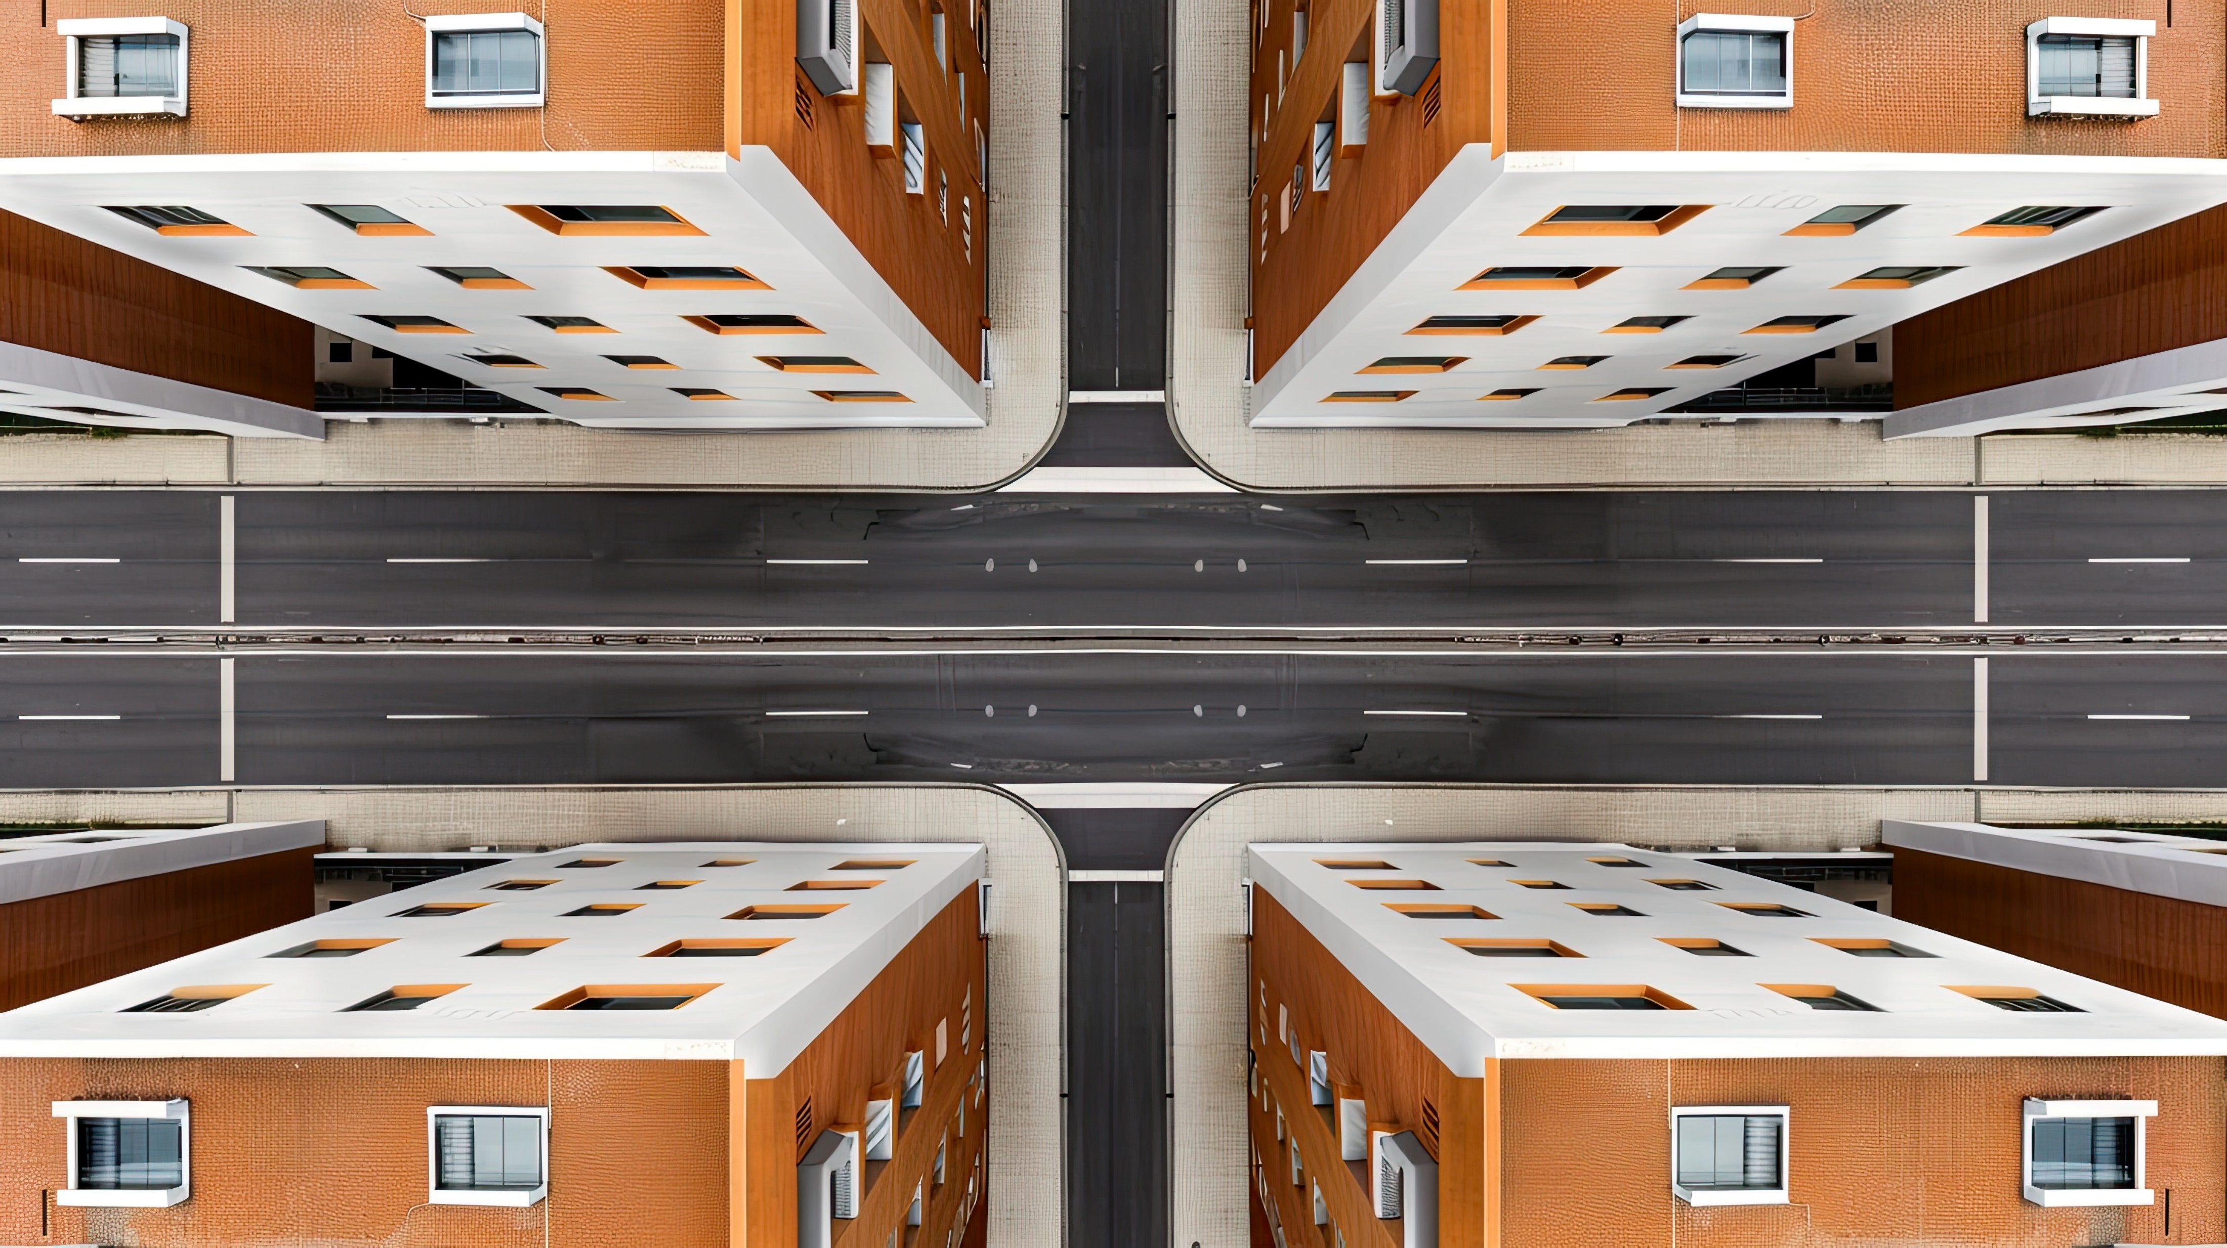
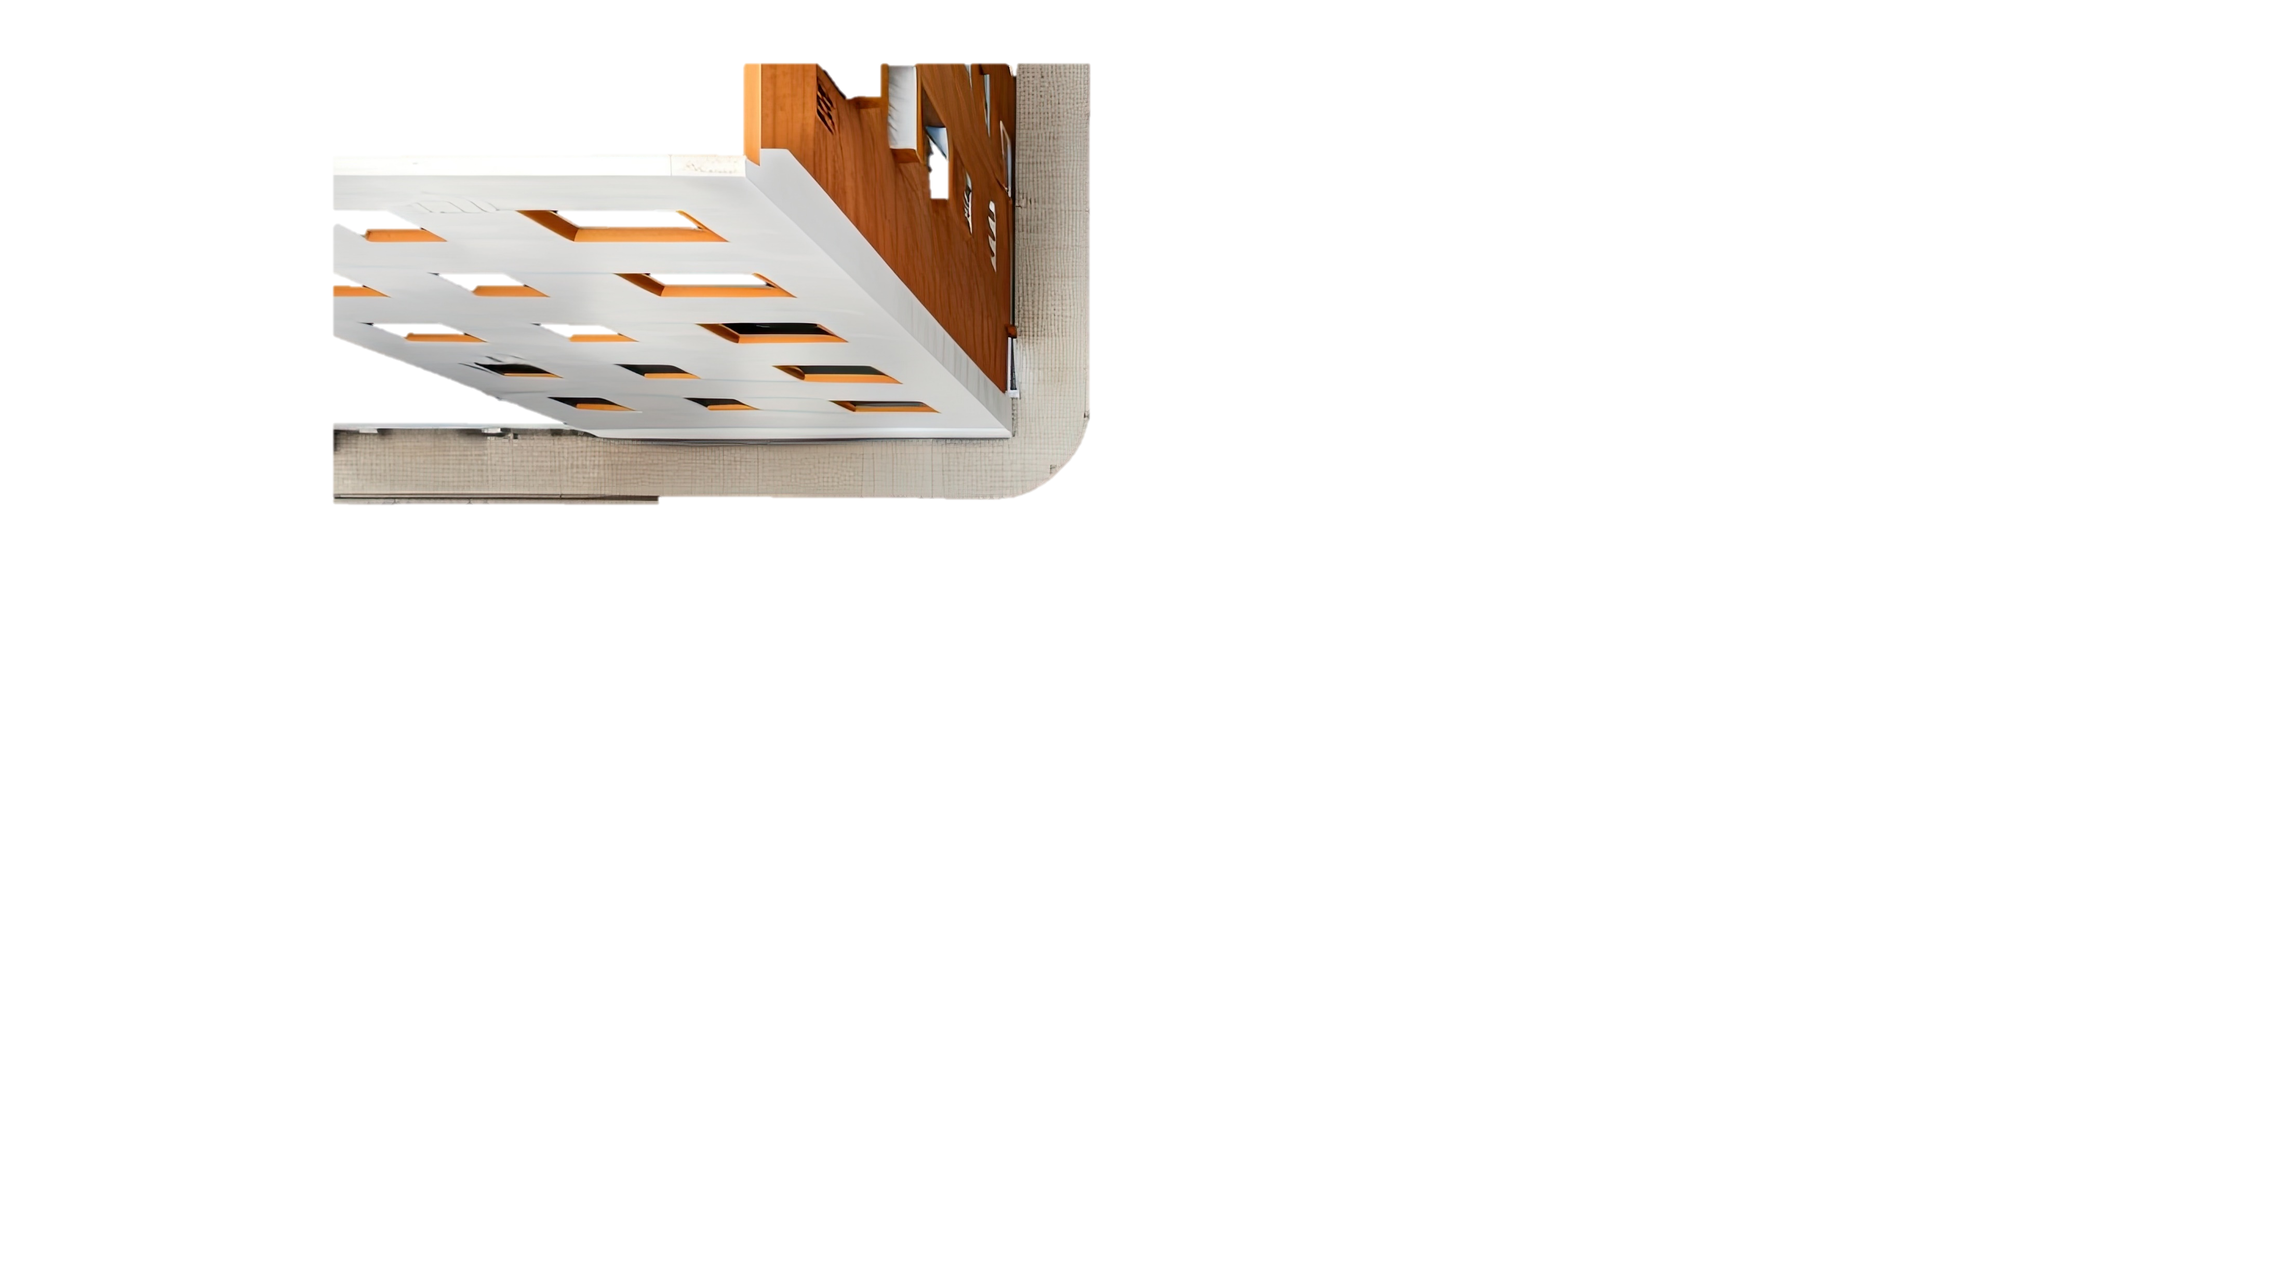
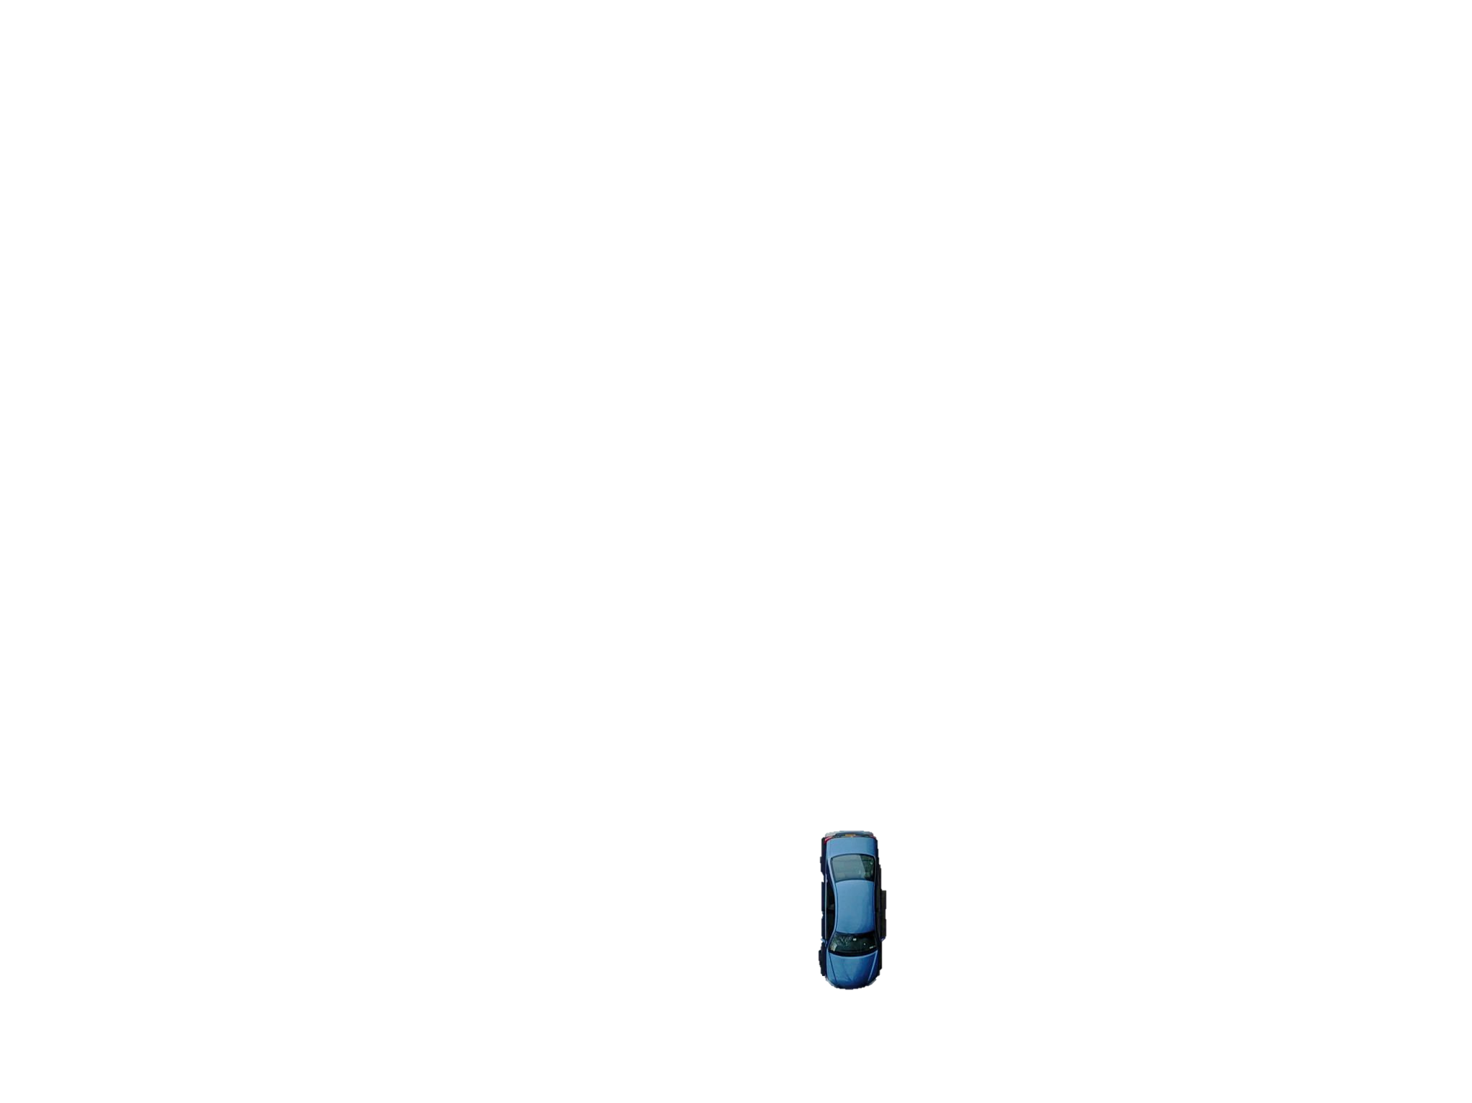
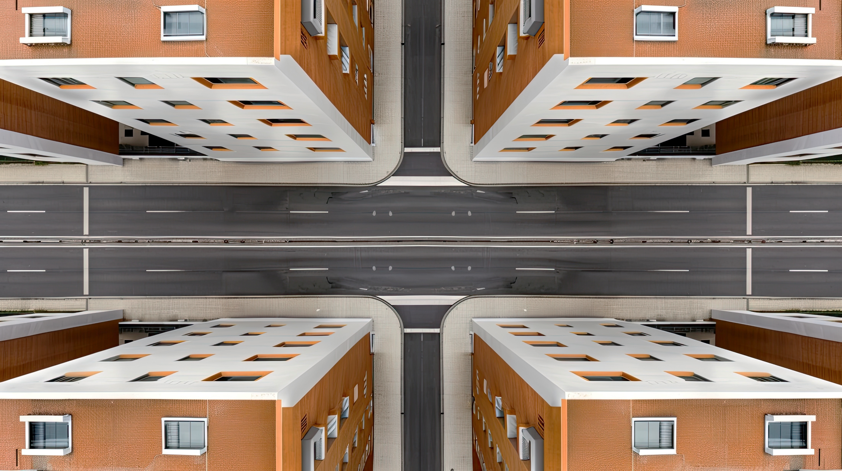

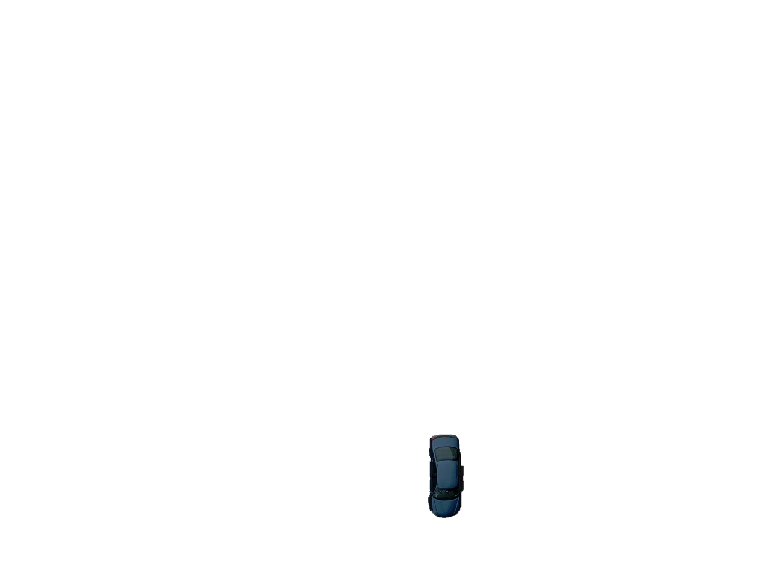

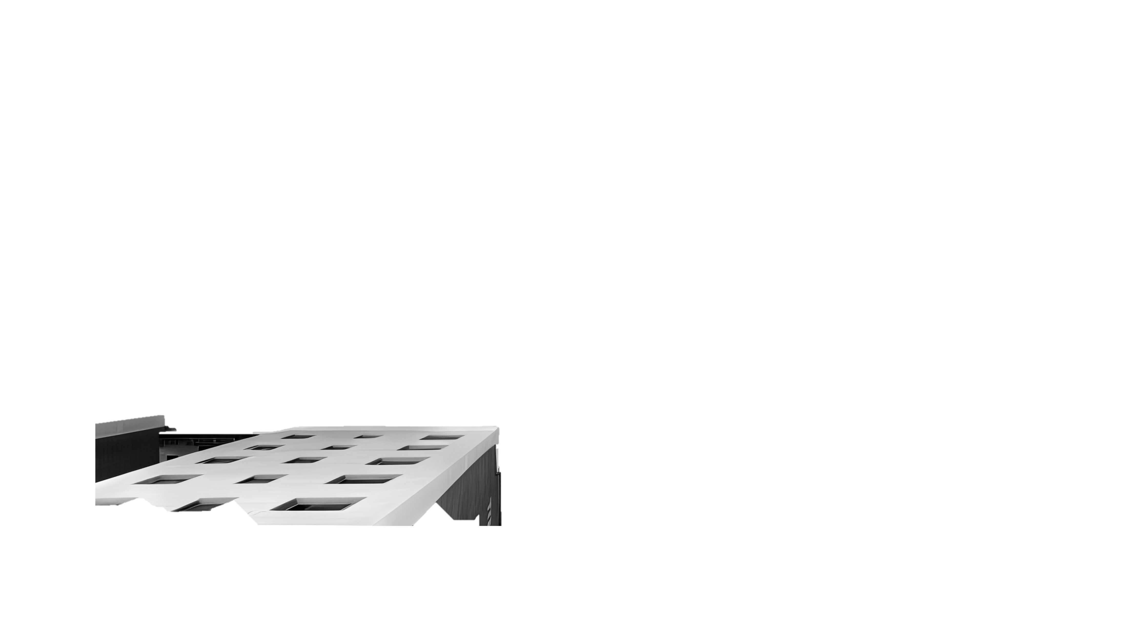
Classic Sensing Modalities are Limited to Line-of-Sight

Slide 3
Can We Produce RF Images of Objects Around-the-Corner?

Slide 4
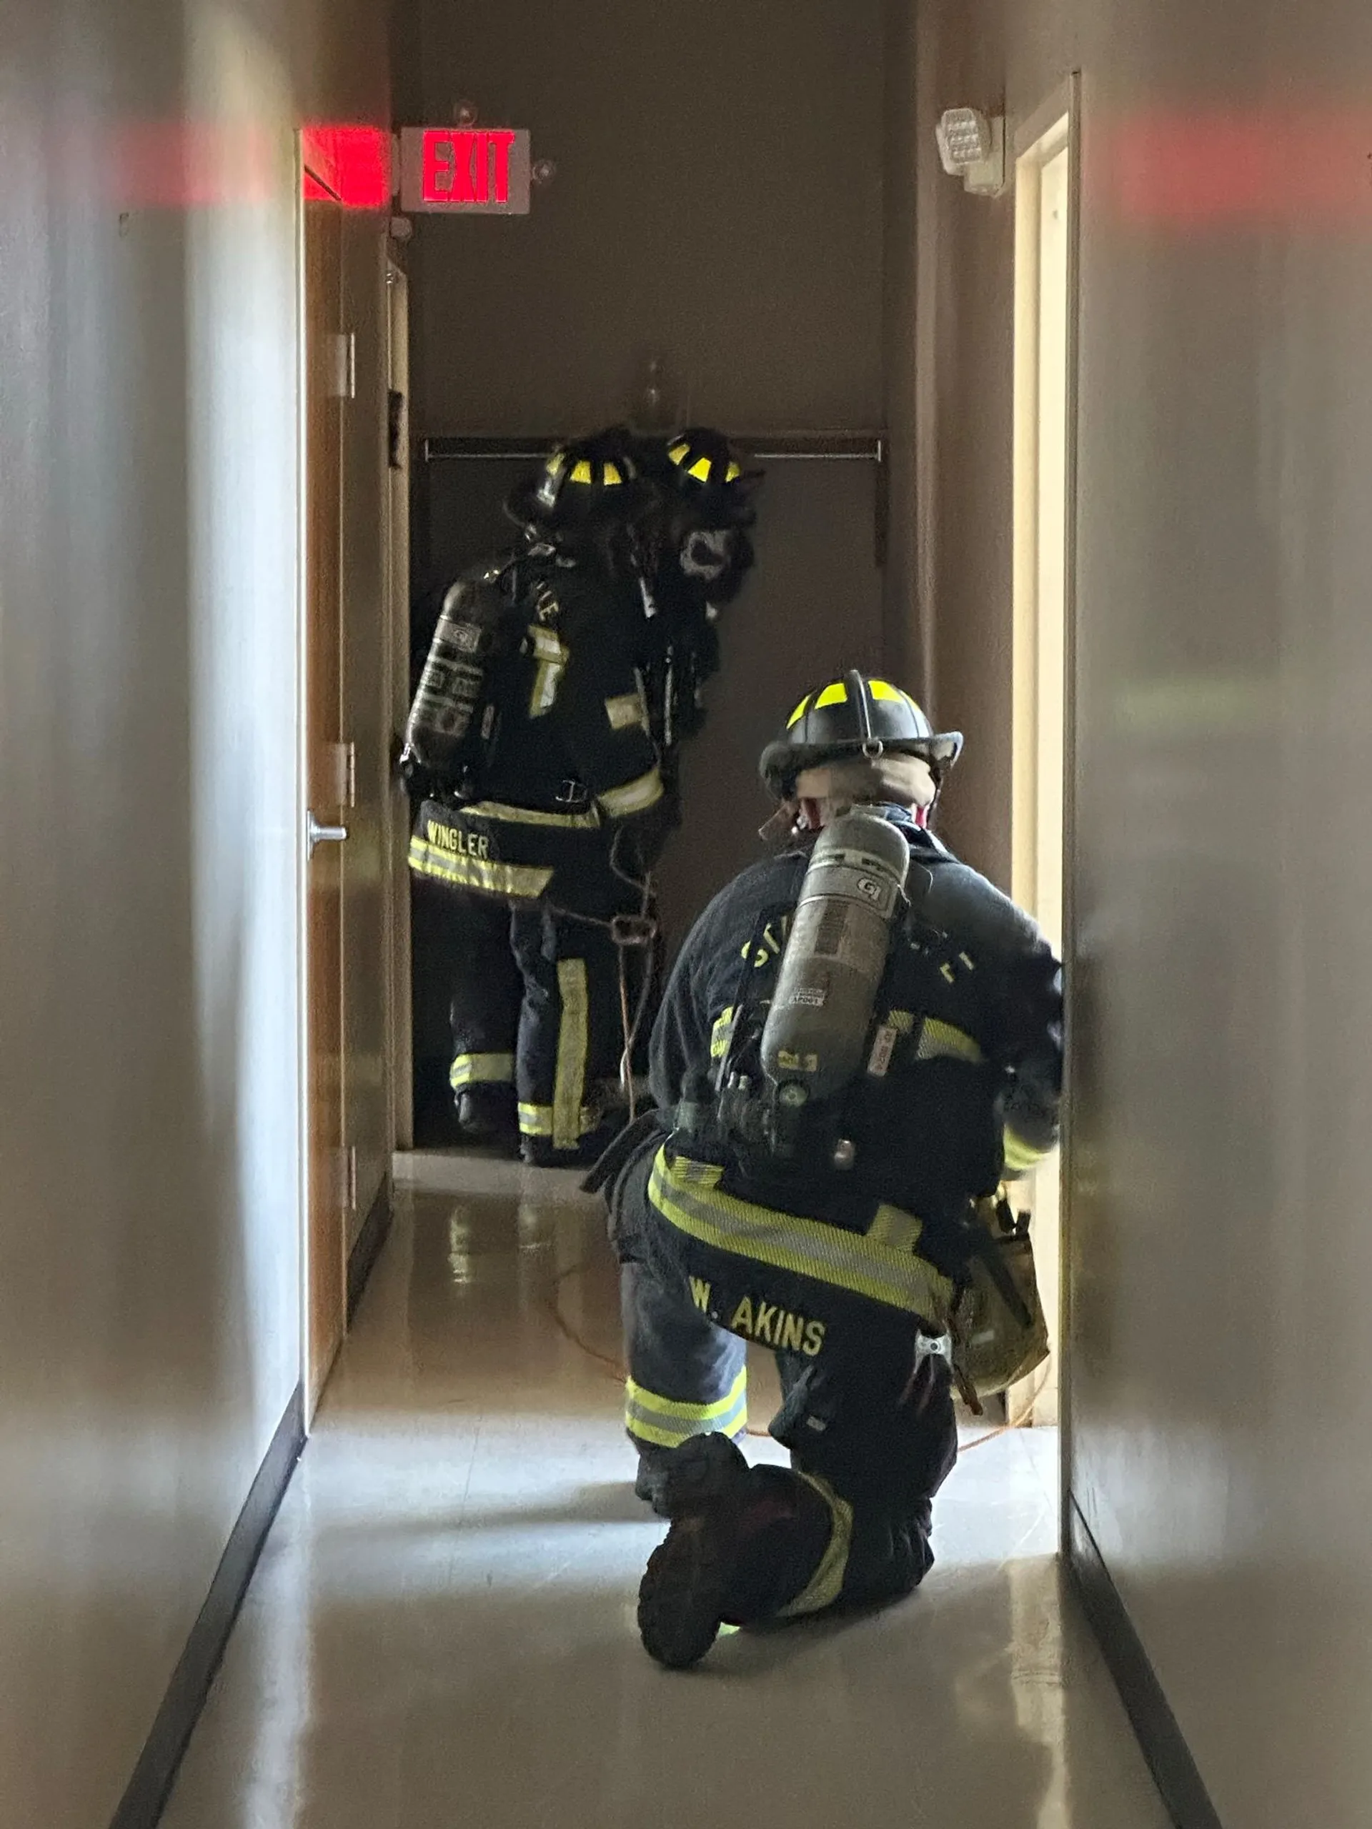
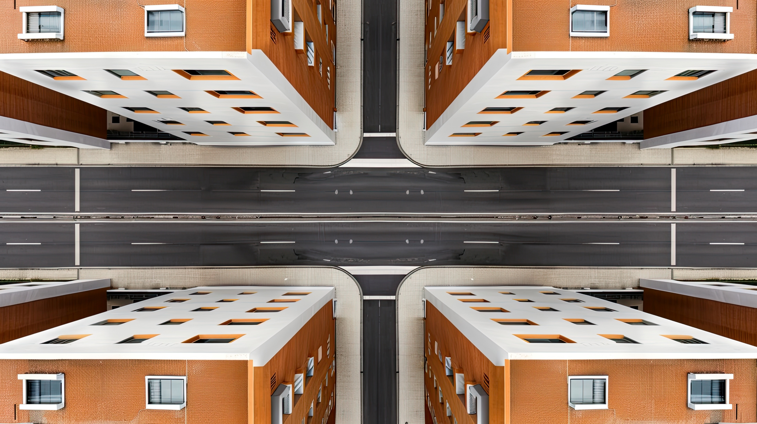


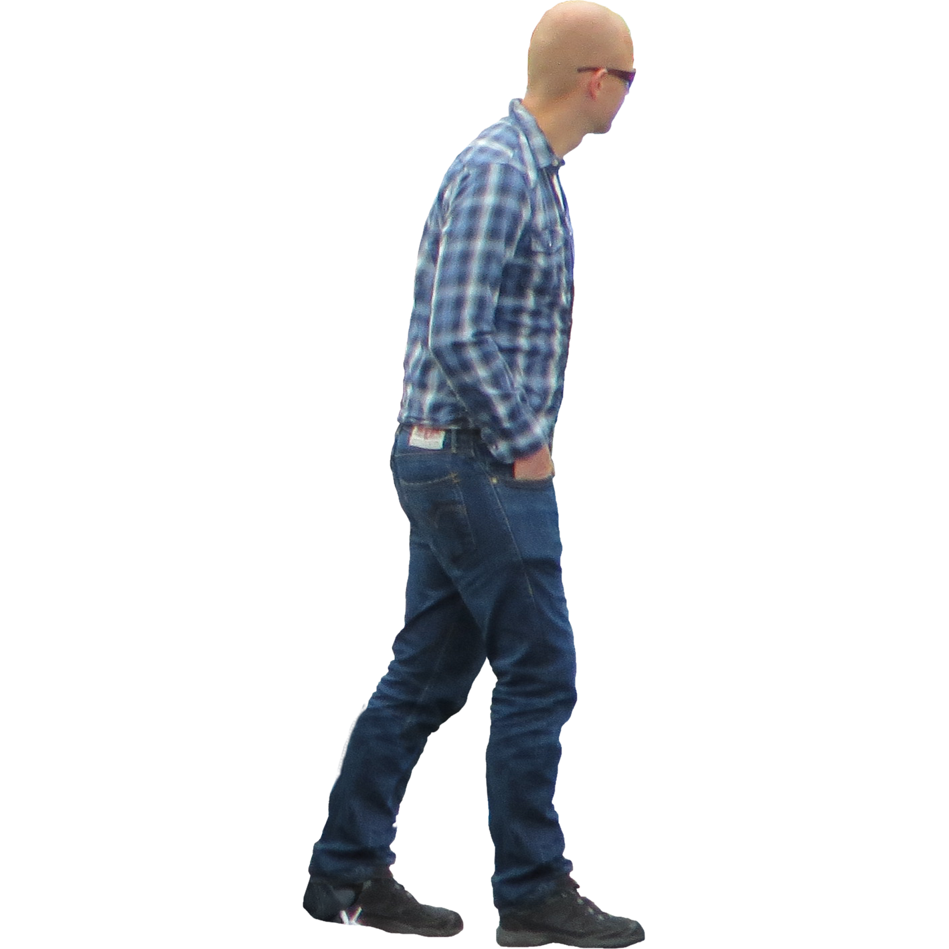

The Ability to Image Around-the-Corner has Many Applications
Autonomous Driving
Robotic Navigation
Search and Rescue
Search and Rescue
Notes:
This ability to sense around the corner has many applications. Beyond autonomous driving, this is also useful in robotic navigation for hospitals, warehouses, manufacturing, and smart homes. Also, it can be used in search-and-rescure to more efficiently search a building for survivors.
Now, there has been significant, exciting adnvaces in non-line-of-sight sensing over the past few years in our community. However, it would be difficult to apply these advances to enable these applications.

Slide 5
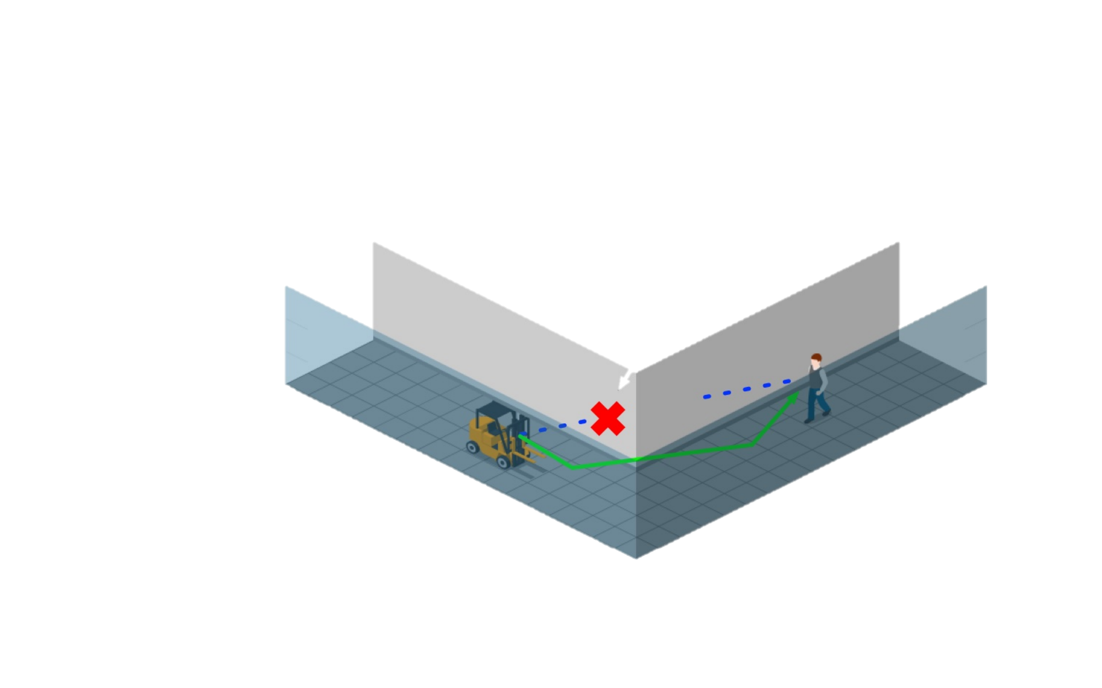
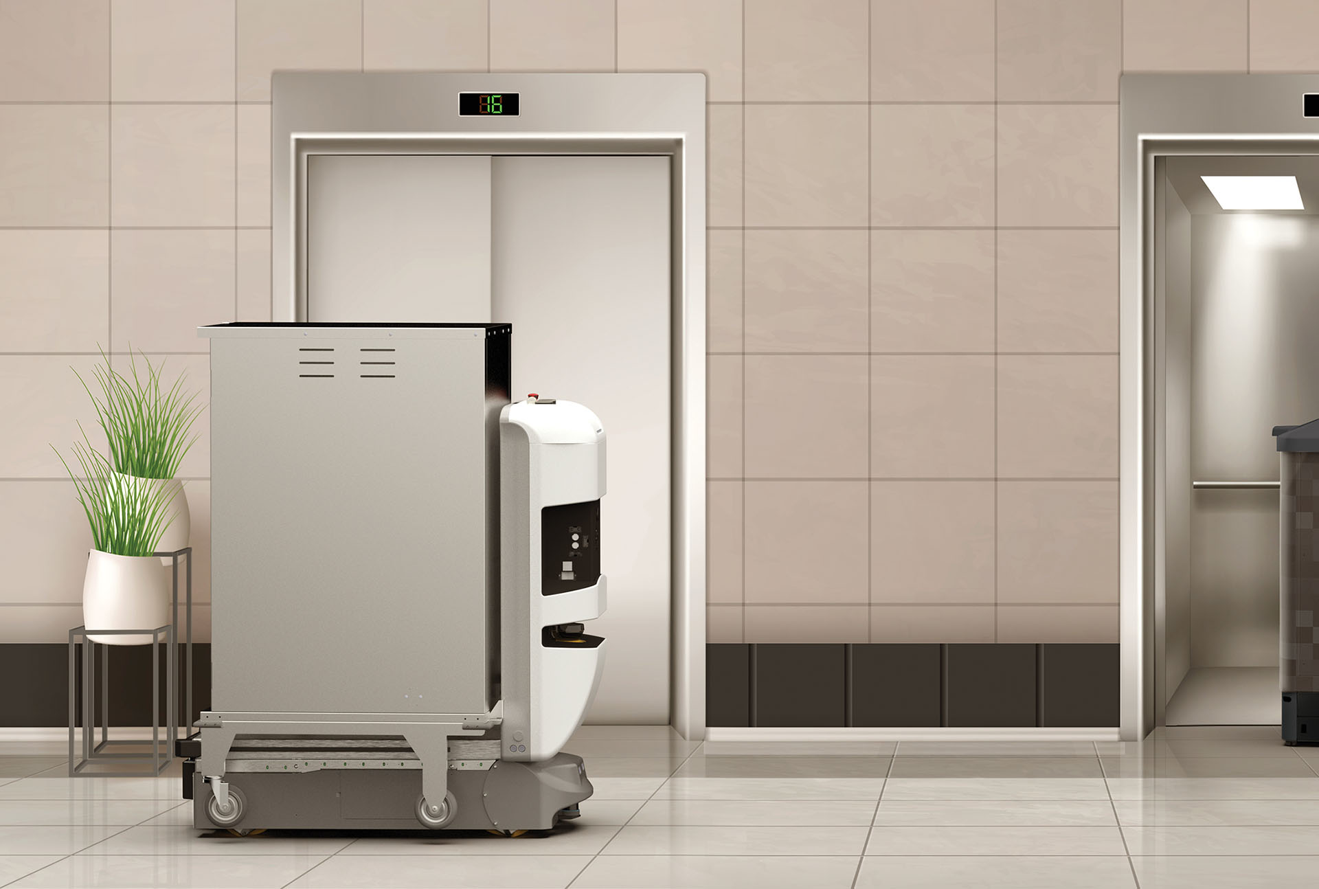
State-of-the-Art RF Non-Line-of-Sight Sensing
RF Through-Occlusion Imaging
RF Around-the-Corner Sensing
Signals Cannot Pass Through All Occlusions (e.g., Metal, Thick Concrete/Brick, etc)
Limited to Localization
AND/OR
Restricted to Specific Environments
Notes:
To understand why, let us look at state-of-the-art NLOS sensing. The vast majority of work falls into two main categories. The first leverages RF Through-Occlusion imaging, where signals are expected to pass through the occlusions to image objects on the other side. However, in many scenarios, RF signals cannot pass through occlusions such as metal, concrete, and brick.
On the other hand, prior work has investigated around the corner sensing. This work involves reflecting signals off a nearby surface to sense objects around a corner. However, most of this work has been limited to localizing, instead of imaging, or restricted to specific environments.

Slide 6
RFlect
First steps towards wireless around-the-corner imaging in practical environments
Introduce techniques for non-planar reflection imaging and precise reflector mapping
Demonstrates, for the first time, high-accuracy around-the-corner imaging off complex reflection geometries
Notes:
Today I am excited to present Rflect, which …

Slide 7
Problem:
Practical Environments Contain a
Variety of Reflecting Surfaces
Notes:
When designing Rflect, we aimed to enable imaging on many different surface geometries. This includes planar surfaces, convex surfaces such as building columns, concave surfaces such as curved walls, and composite surfaces, where multiple different surfaces reflect signals around the corner.
Unfortunately, we will not have time to cover all of these scenarios today, so I will be focusing on convex surfaces, and invite you to check out the paper for more details on other scenarios.

Slide 8
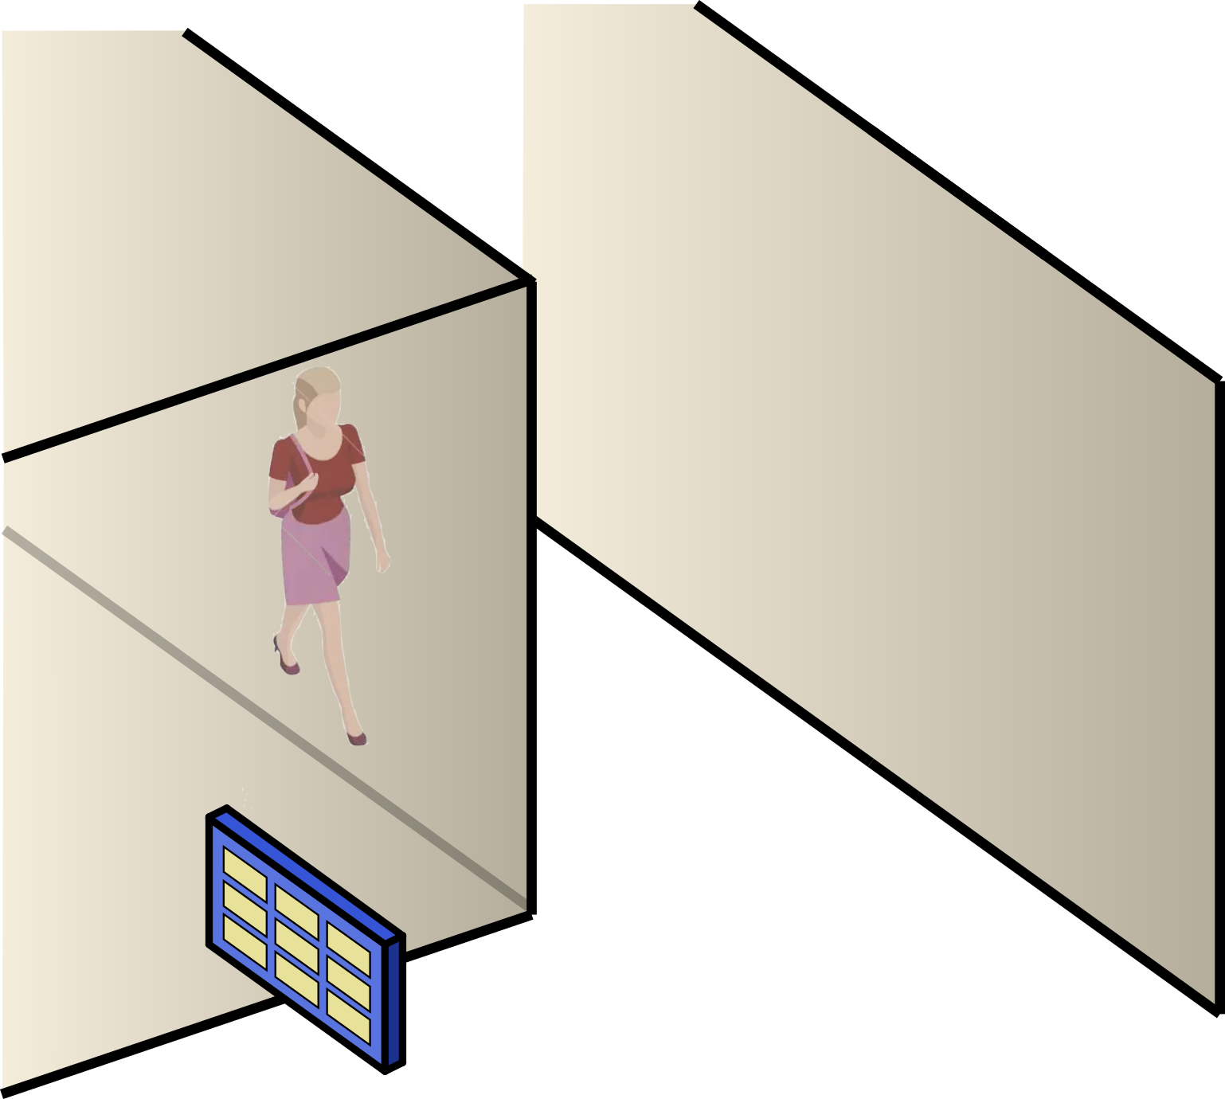
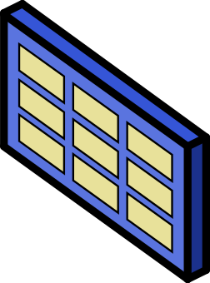
Practical Environments Contain a Variety of Reflecting Surfaces
Hidden
Target Object
mmWave
Antenna Array
Planar Surfaces
Notes:
When designing Rflect, we aimed to enable imaging on many different surface geometries. This includes planar surfaces, convex surfaces such as building columns, concave surfaces such as curved walls, and composite surfaces, where multiple different surfaces reflect signals around the corner.
Unfortunately, we will not have time to cover all of these scenarios today, so I will be focusing on convex surfaces, and invite you to check out the paper for more details on other scenarios.

Slide 9
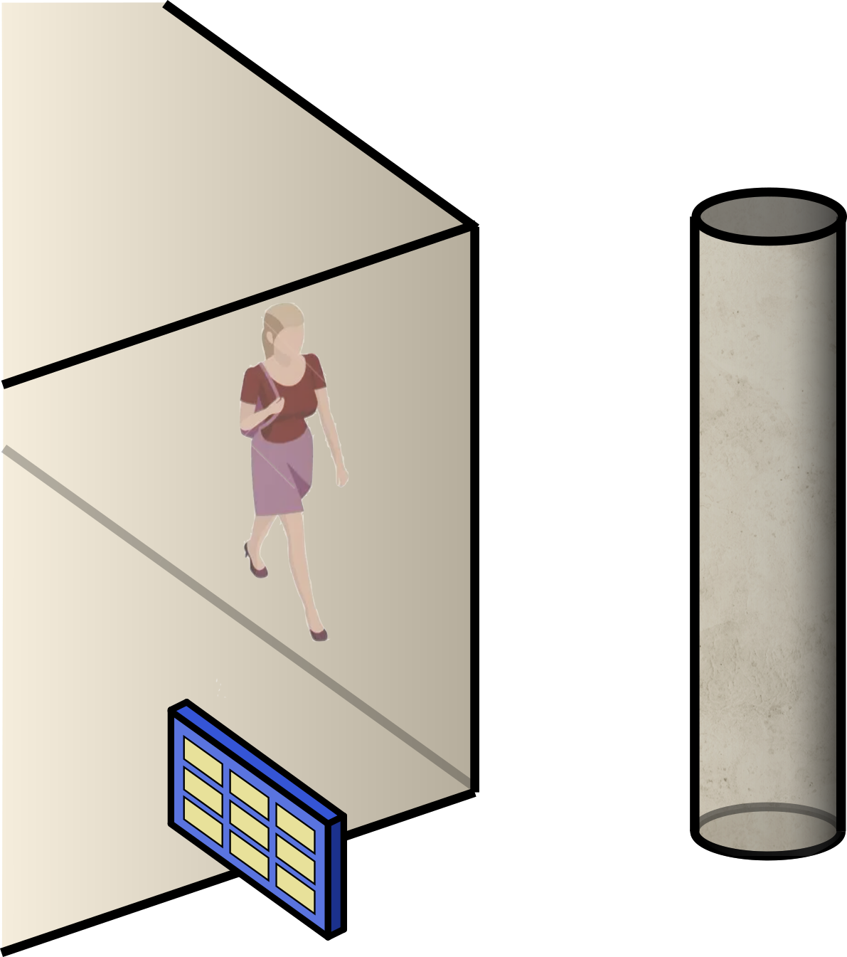
Practical Environments Contain a Variety of Reflecting Surfaces
Convex Surfaces
Planar Surfaces
Notes:
When designing Rflect, we aimed to enable imaging on many different surface geometries. This includes planar surfaces, convex surfaces such as building columns, concave surfaces such as curved walls, and composite surfaces, where multiple different surfaces reflect signals around the corner.
Unfortunately, we will not have time to cover all of these scenarios today, so I will be focusing on convex surfaces, and invite you to check out the paper for more details on other scenarios.

Slide 10
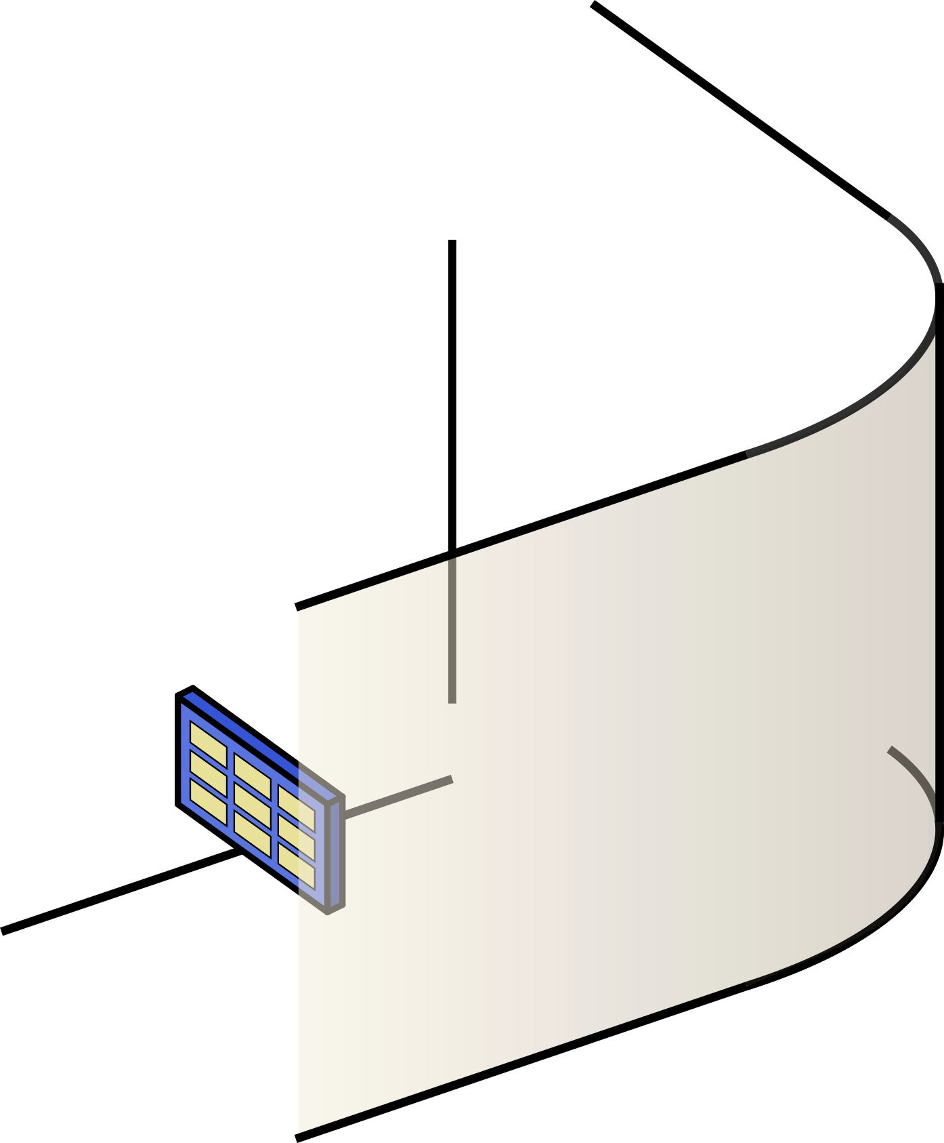
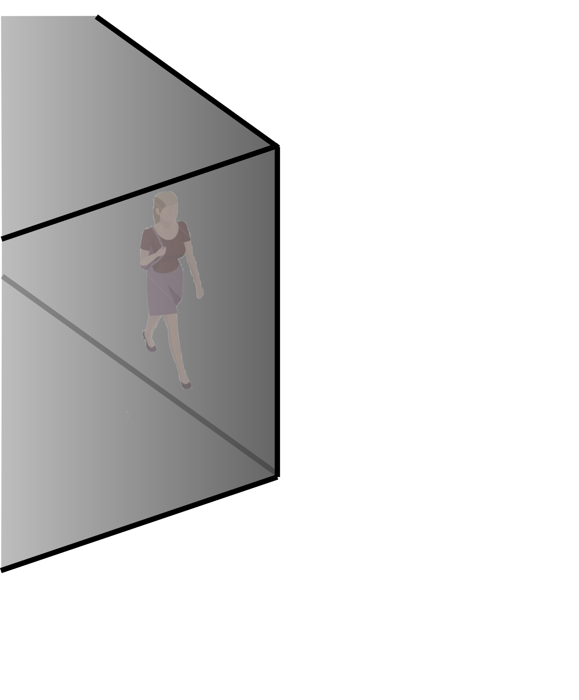
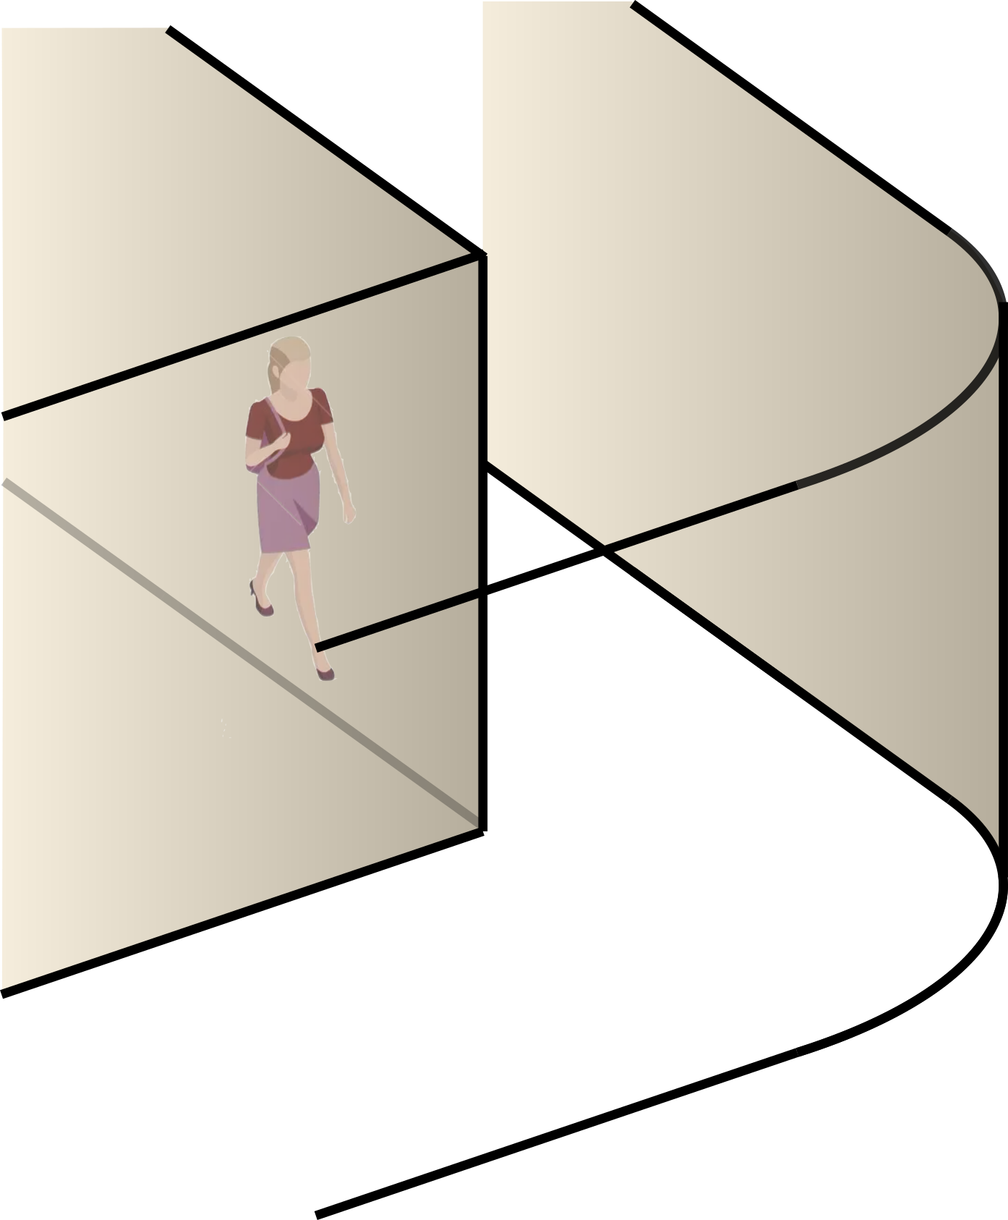
Practical Environments Contain a Variety of Reflecting Surfaces
Convex Surfaces
Concave Surfaces
Planar Surfaces
Notes:
When designing Rflect, we aimed to enable imaging on many different surface geometries. This includes planar surfaces, convex surfaces such as building columns, concave surfaces such as curved walls, and composite surfaces, where multiple different surfaces reflect signals around the corner.
Unfortunately, we will not have time to cover all of these scenarios today, so I will be focusing on convex surfaces, and invite you to check out the paper for more details on other scenarios.

Slide 11
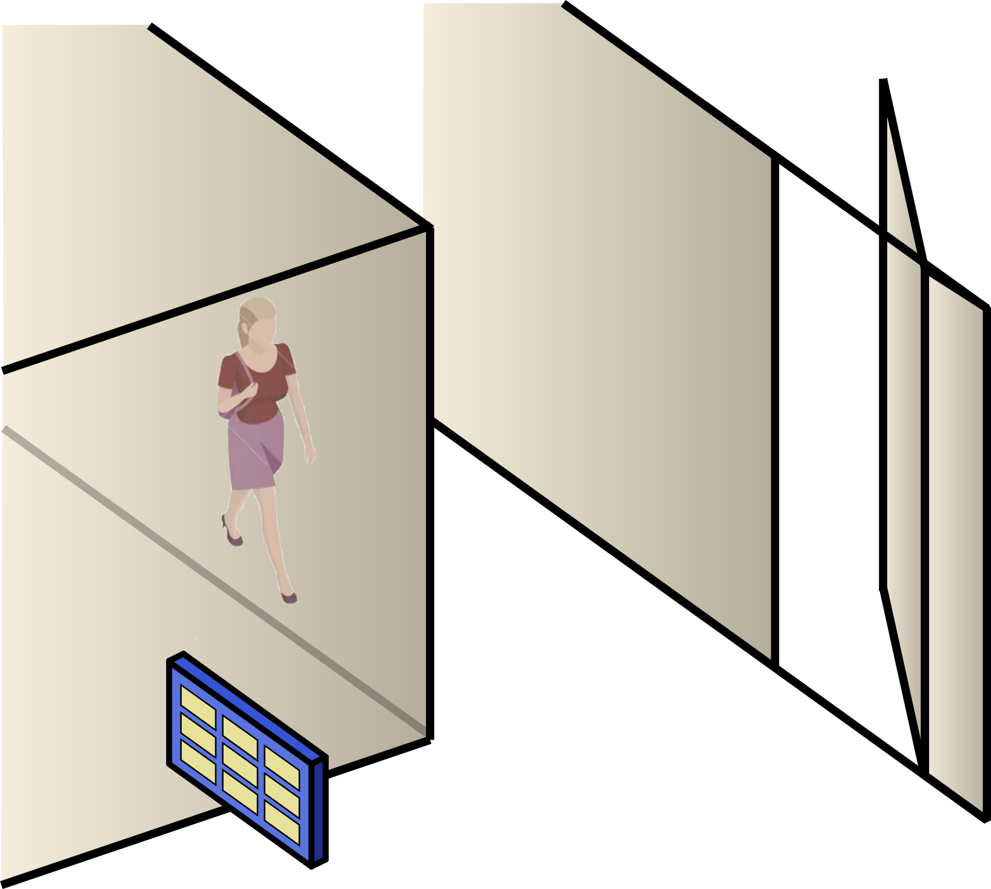
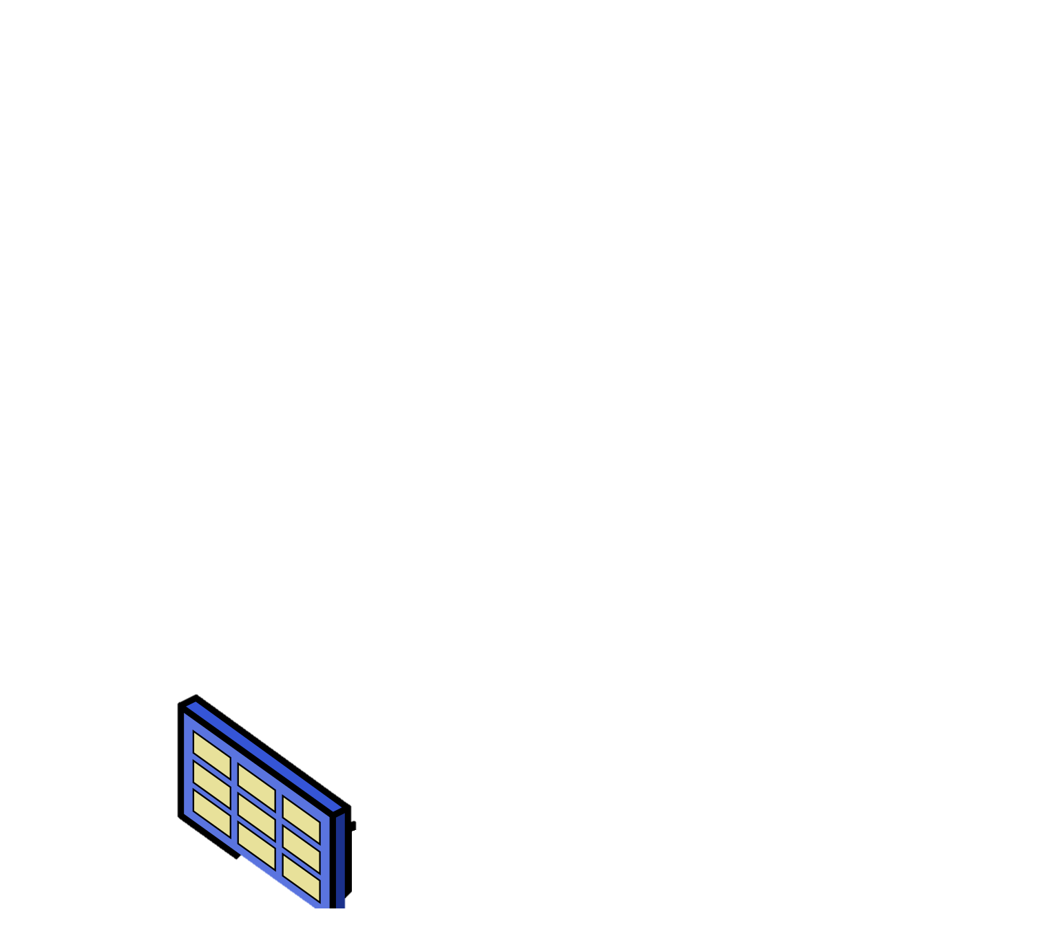
Practical Environments Contain a Variety of Reflecting Surfaces
Convex Surfaces
Composite Surfaces
Planar Surfaces
Concave Surfaces
Notes:
When designing Rflect, we aimed to enable imaging on many different surface geometries. This includes planar surfaces, convex surfaces such as building columns, concave surfaces such as curved walls, and composite surfaces, where multiple different surfaces reflect signals around the corner.
Unfortunately, we will not have time to cover all of these scenarios today, so I will be focusing on convex surfaces, and invite you to check out the paper for more details on other scenarios.

Slide 12
Practical Environments Contain a Variety of Reflecting Surfaces
Convex Surfaces
Composite Surfaces
Planar Surfaces
Concave Surfaces
Notes:
When designing Rflect, we aimed to enable imaging on many different surface geometries. This includes planar surfaces, convex surfaces such as building columns, concave surfaces such as curved walls, and composite surfaces, where multiple different surfaces reflect signals around the corner.
Unfortunately, we will not have time to cover all of these scenarios today, so I will be focusing on convex surfaces, and invite you to check out the paper for more details on other scenarios.

Slide 13

How Can We Image off Planar Surfaces?
Standard Imaging Algorithms Produce Mirrored Images
Notes:
When designing Rflect, we aimed to enable imaging on many different surface geometries. This includes planar surfaces, convex surfaces such as building columns, concave surfaces such as curved walls, and composite surfaces, where multiple different surfaces reflect signals around the corner.
Unfortunately, we will not have time to cover all of these scenarios today, so I will be focusing on convex surfaces, and invite you to check out the paper for more details on other scenarios.

Slide 14
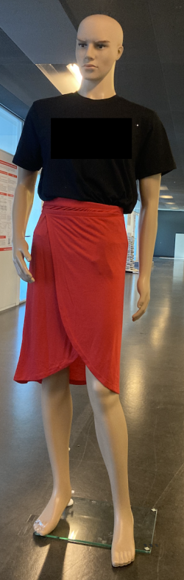
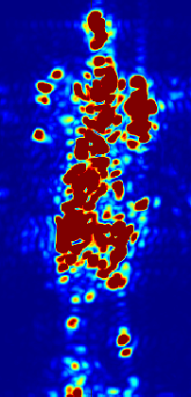
How Can We Image off Planar Surfaces?
Target
RFlect
Notes:
When designing Rflect, we aimed to enable imaging on many different surface geometries. This includes planar surfaces, convex surfaces such as building columns, concave surfaces such as curved walls, and composite surfaces, where multiple different surfaces reflect signals around the corner.
Unfortunately, we will not have time to cover all of these scenarios today, so I will be focusing on convex surfaces, and invite you to check out the paper for more details on other scenarios.

Slide 15
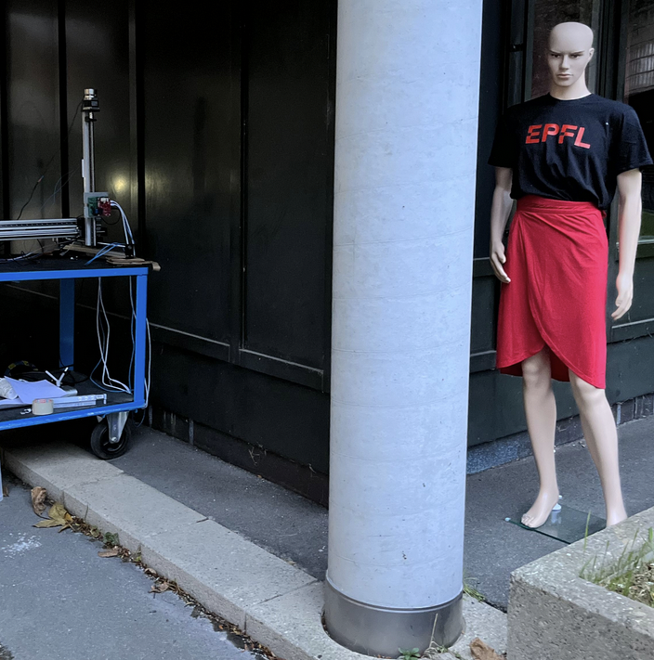
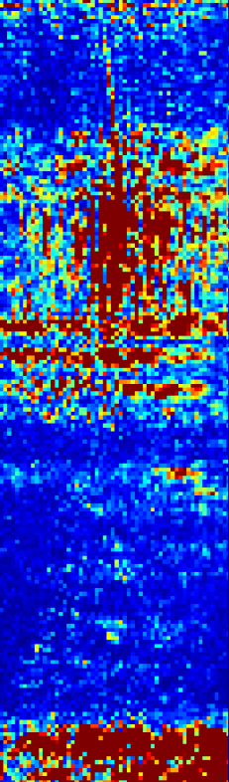
Can We Use the Same Approach for More Complex Surfaces?
Hidden Target Object
Reflection Surface
mmWave
Radar
Complex environments require more sophisticated modeling techniques
Convex Building Column
Image When Using Standard Imaging Algorithms
Complex environments require more sophisticated modeling techniques
Notes:
When designing Rflect, we aimed to enable imaging on many different surface geometries. This includes planar surfaces, convex surfaces such as building columns, concave surfaces such as curved walls, and composite surfaces, where multiple different surfaces reflect signals around the corner.
Unfortunately, we will not have time to cover all of these scenarios today, so I will be focusing on convex surfaces, and invite you to check out the paper for more details on other scenarios.

Slide 16
How can we know the geometry and location of the reflecting surface?
How can we accurately model reflections to enable coherent imaging?
What is the theoretical resolution & coverage for different reflectors?
Notes:
When designing Rflect, we aimed to enable imaging on many different surface geometries. This includes planar surfaces, convex surfaces such as building columns, concave surfaces such as curved walls, and composite surfaces, where multiple different surfaces reflect signals around the corner.
Unfortunately, we will not have time to cover all of these scenarios today, so I will be focusing on convex surfaces, and invite you to check out the paper for more details on other scenarios.

Slide 17
What Happens When There Are Errors In The Reflector Mapping?
Voxel
Notes:
When designing Rflect, we aimed to enable imaging on many different surface geometries. This includes planar surfaces, convex surfaces such as building columns, concave surfaces such as curved walls, and composite surfaces, where multiple different surfaces reflect signals around the corner.
Unfortunately, we will not have time to cover all of these scenarios today, so I will be focusing on convex surfaces, and invite you to check out the paper for more details on other scenarios.

Slide 18
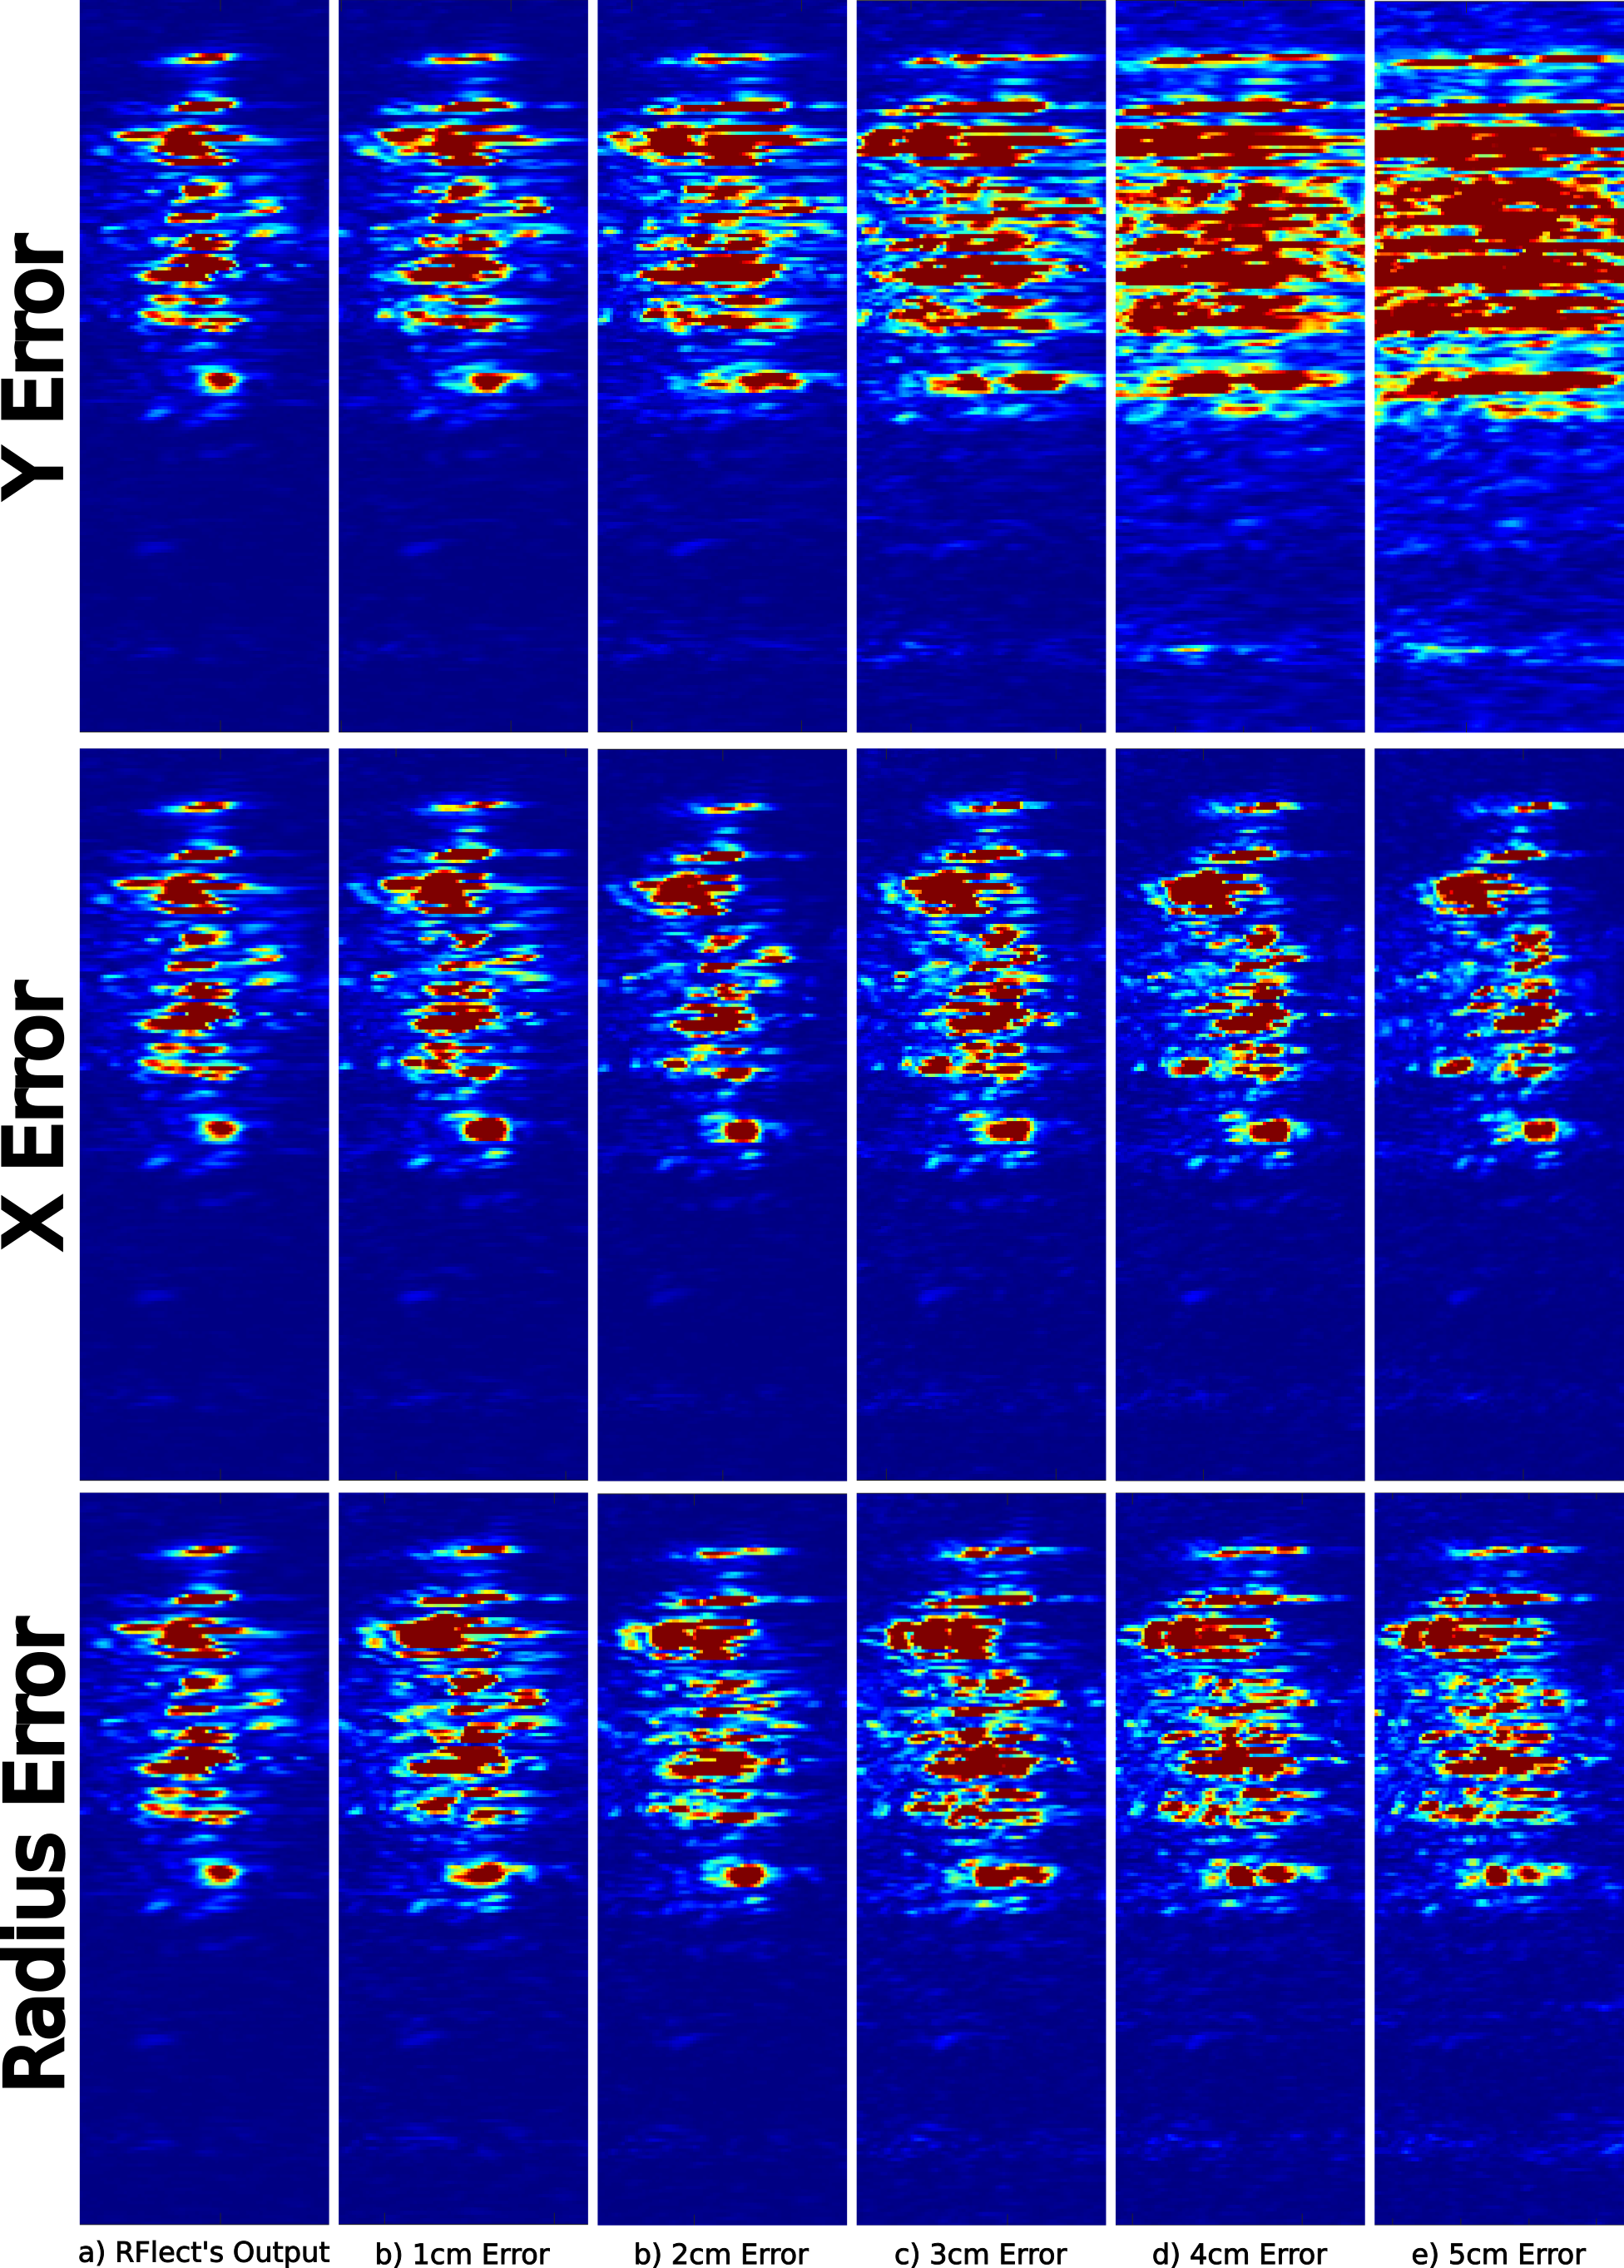
Impact of Reflector Mapping Accuracy
Produce images with RFlect’s Non-Linear Imaging Algorithm
With Small Error in Convex Reflector Location
Image Distortions
High-accuracy reflector mapping is key to producing accurate around-the-corner images
Target
3 cm
5 cm
Radius Error
e) 1 cm
f) 3 cm
g) 5 cm

Slide 19
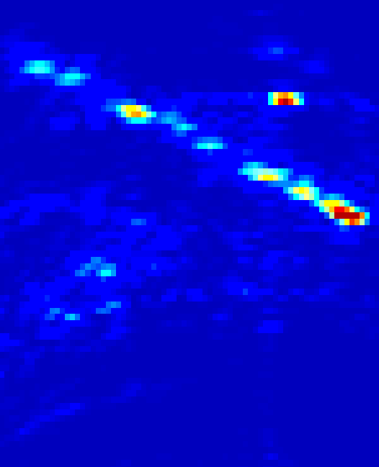
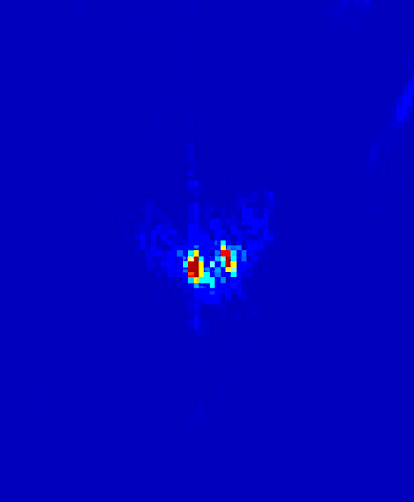
Can We Leverage Line-of-Sight Images for Reflector Mapping?
Line-of-Sight images are not sufficient for mapping
complex reflectors
Our Solution: Design a non-linear reflector mapping algorithm leveraging line-of-sight reflections
Line-of-Sight Overhead View
Planar Reflector
Line-of-Sight Overhead View
Convex Reflector

Slide 20
Solution: Non-Linear Reflector Mapping Algorithm
Step 1: Reduce reflectors to low-dimensional model
(x, y,
r)
Notes:
When designing Rflect, we aimed to enable imaging on many different surface geometries. This includes planar surfaces, convex surfaces such as building columns, concave surfaces such as curved walls, and composite surfaces, where multiple different surfaces reflect signals around the corner.
Unfortunately, we will not have time to cover all of these scenarios today, so I will be focusing on convex surfaces, and invite you to check out the paper for more details on other scenarios.

Slide 21
Solution: Non-Linear Reflector Mapping Algorithm
Step 2: Generate Candidate Surface and Evaluate its Match
(x’, y’, r’)
(x, y,
r)
Notes:
When designing Rflect, we aimed to enable imaging on many different surface geometries. This includes planar surfaces, convex surfaces such as building columns, concave surfaces such as curved walls, and composite surfaces, where multiple different surfaces reflect signals around the corner.
Unfortunately, we will not have time to cover all of these scenarios today, so I will be focusing on convex surfaces, and invite you to check out the paper for more details on other scenarios.

Slide 22

Solution: Non-Linear Reflector Mapping Algorithm
Step 2: Generate Candidate Surface and Evaluate its Match
Candidate Surface Score
RFlect produces candidate scores by comparing received
line-of-sight reflections with the candidate model
$$S(x,y,r)=\sum_{i=1}^{A}{\sum_{j=1}^{N}{s(n,i)}e^{j2π d_{i} (f+kn)/c}}$$
Notes:
When designing Rflect, we aimed to enable imaging on many different surface geometries. This includes planar surfaces, convex surfaces such as building columns, concave surfaces such as curved walls, and composite surfaces, where multiple different surfaces reflect signals around the corner.
Unfortunately, we will not have time to cover all of these scenarios today, so I will be focusing on convex surfaces, and invite you to check out the paper for more details on other scenarios.

Slide 23
Solution: Non-Linear Reflector Mapping Algorithm
Step 3: Search Across Candidate Surfaces
Candidate Surface Score
Notes:
When designing Rflect, we aimed to enable imaging on many different surface geometries. This includes planar surfaces, convex surfaces such as building columns, concave surfaces such as curved walls, and composite surfaces, where multiple different surfaces reflect signals around the corner.
Unfortunately, we will not have time to cover all of these scenarios today, so I will be focusing on convex surfaces, and invite you to check out the paper for more details on other scenarios.

Slide 24
Solution: Non-Linear Reflector Mapping Algorithm
Step 3: Search Across Candidate Surfaces
Candidate Surface Score
Choose the surface with the highest score
& apply RFlect’s
non-linear imaging algorithm
Notes:
When designing Rflect, we aimed to enable imaging on many different surface geometries. This includes planar surfaces, convex surfaces such as building columns, concave surfaces such as curved walls, and composite surfaces, where multiple different surfaces reflect signals around the corner.
Unfortunately, we will not have time to cover all of these scenarios today, so I will be focusing on convex surfaces, and invite you to check out the paper for more details on other scenarios.

Slide 25
Solution: Non-Linear Reflector Mapping Algorithm
Step 3: Search Across Candidate Surfaces
RFlect’s reflector mapping algorithm enables
high-accuracy around-the-corner imaging
Target
RFlect
Notes:
When designing Rflect, we aimed to enable imaging on many different surface geometries. This includes planar surfaces, convex surfaces such as building columns, concave surfaces such as curved walls, and composite surfaces, where multiple different surfaces reflect signals around the corner.
Unfortunately, we will not have time to cover all of these scenarios today, so I will be focusing on convex surfaces, and invite you to check out the paper for more details on other scenarios.

Slide 26
How can we know the geometry and location of the reflecting surface?
Introduce Non-Linear Reflector Mapping
How can we accurately model reflections to enable coherent imaging?
What is the theoretical resolution & coverage for different reflectors?
Notes:
In summary, I showed you how we introduce a non-linear reflector mapping algorithm for finding geometry and location of the reflecting surface.
In our paper, you can also see how we enable coherent imaging and derive the theoretical resolution and coverage.

Slide 27
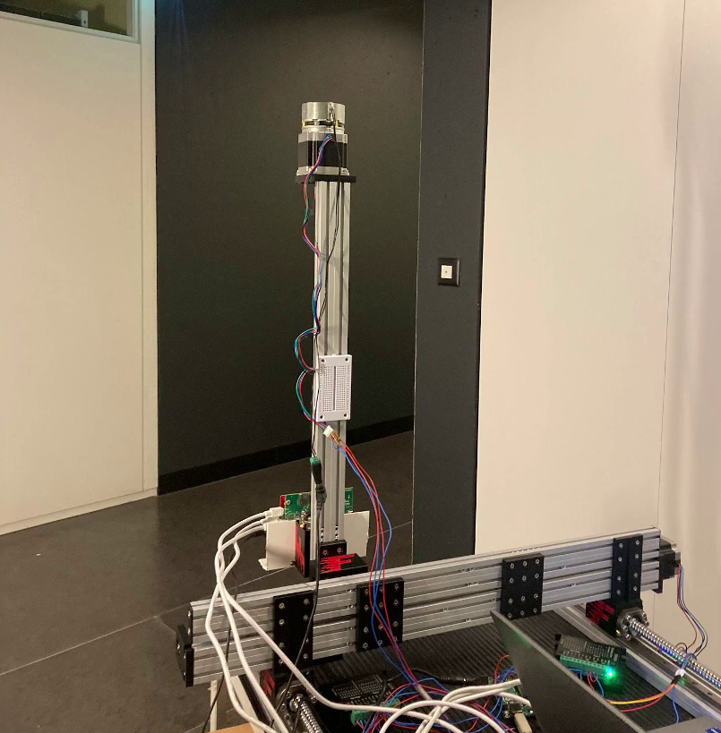
Implementation
2D Linear Stage
TI AWR1843Boost 77GHz mmWave Radar
2D Linear Stage to create a synthetic aperture
Leveraged reflectors with various materials (concrete, wood, glass, metal, plastic)
Reflection Surface
77GHz
mmWave
Radar

Slide 28

Planar Imaging Results
Target Objects
Baseline: Image objects in line-of-sight of radar
Baseline: LOS
RFlect Around-the-Corner Imaging off Planar Surfaces
RFlect Planar

Slide 29
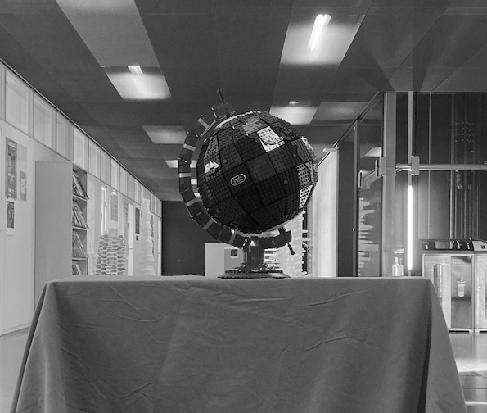
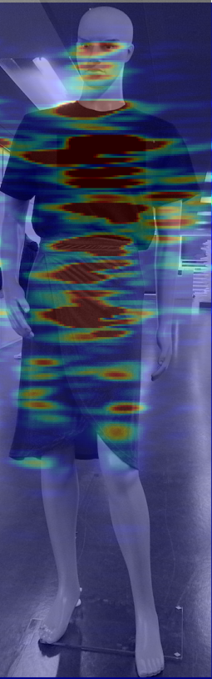
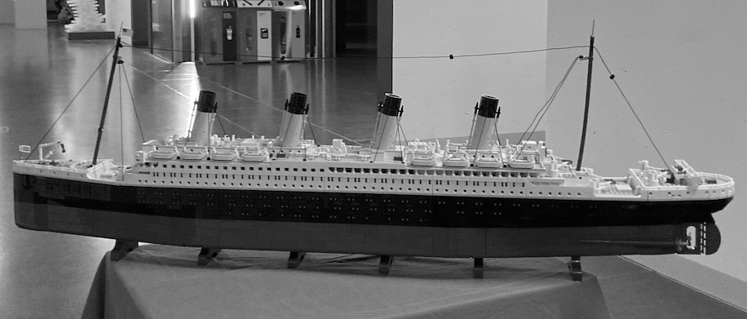
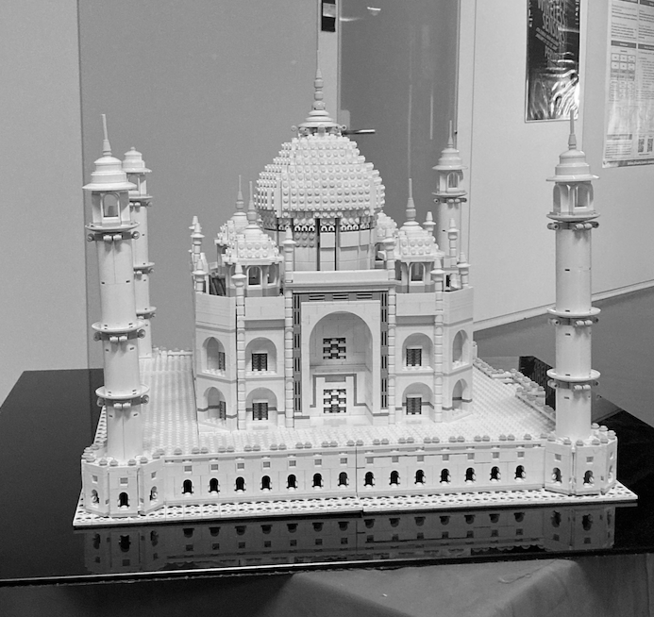
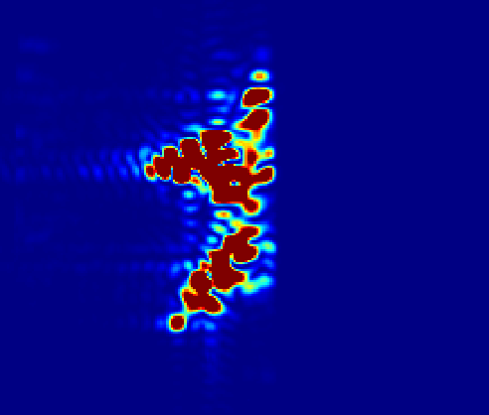
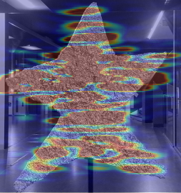
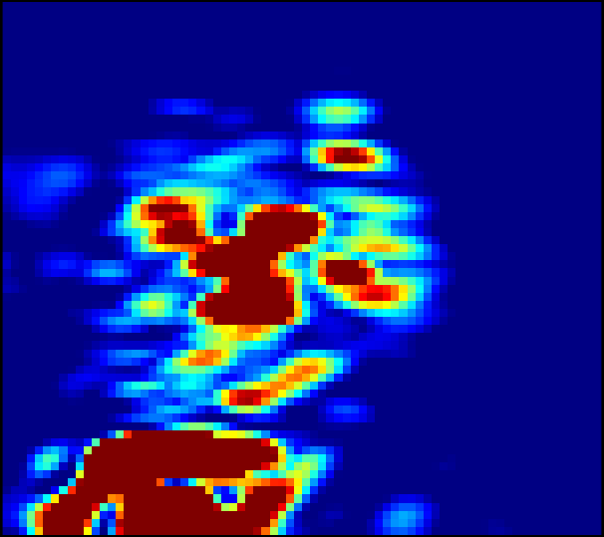
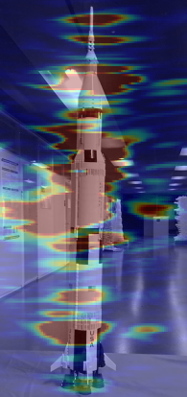
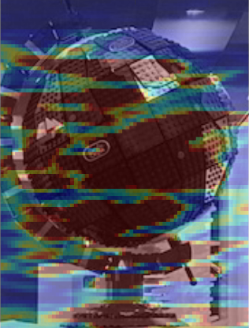
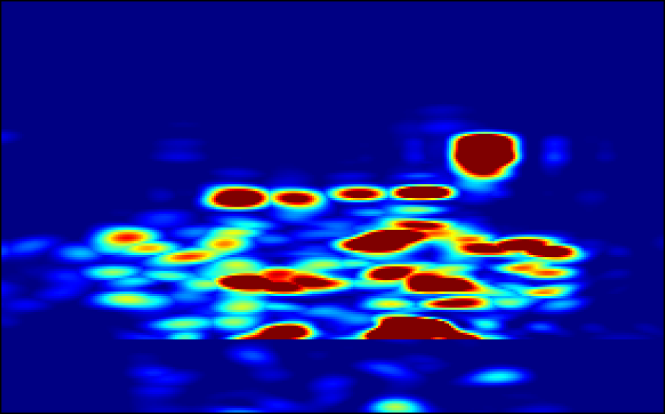
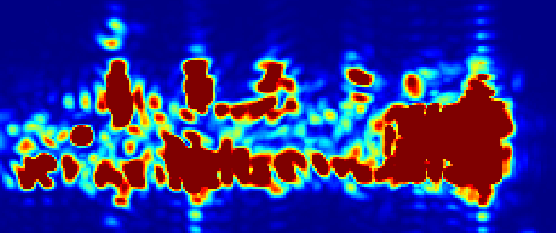
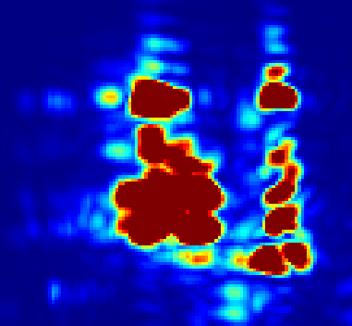
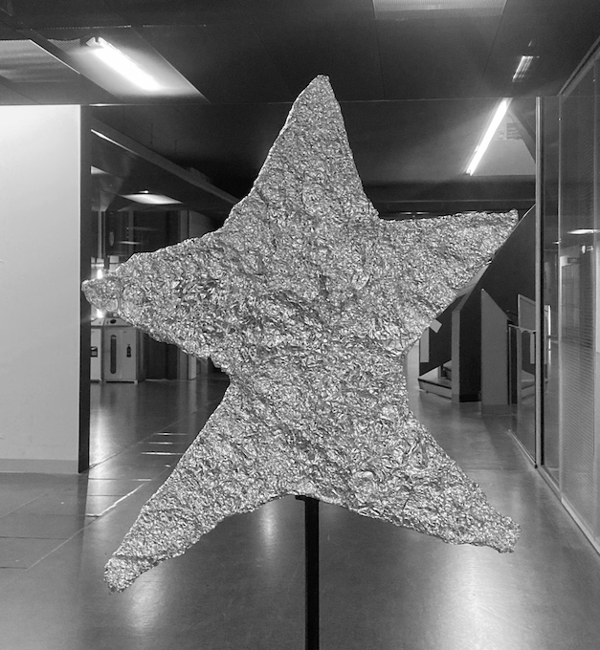
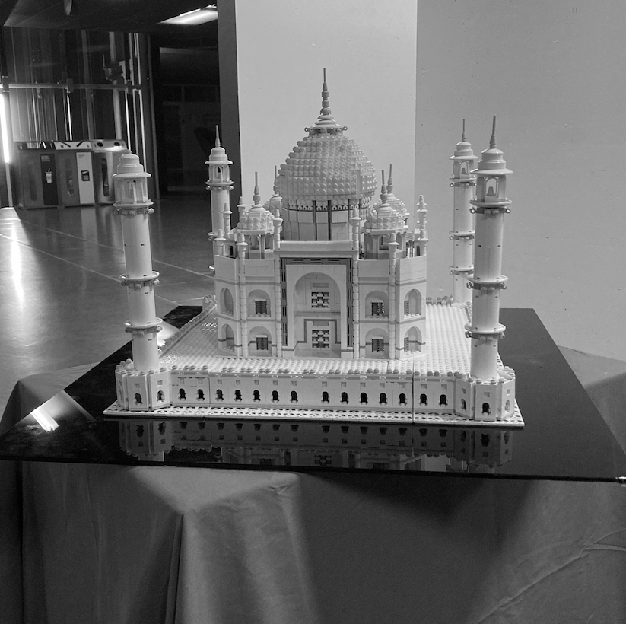
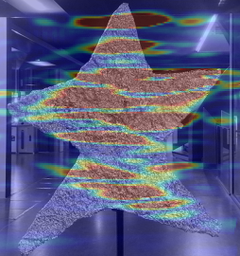
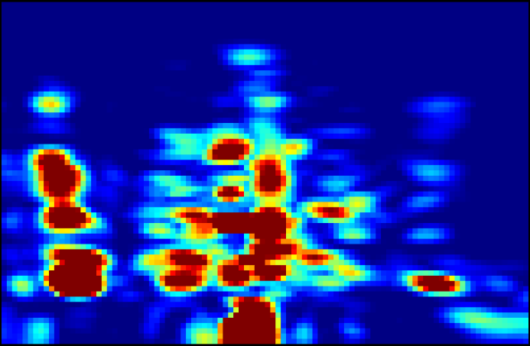
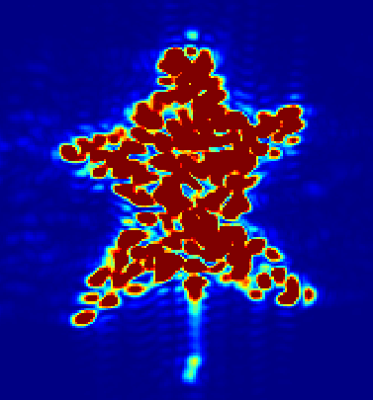
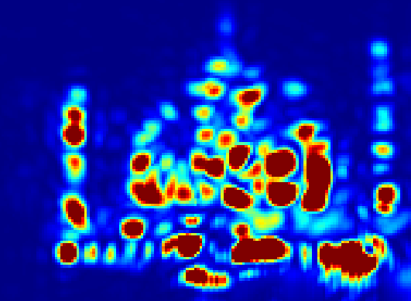
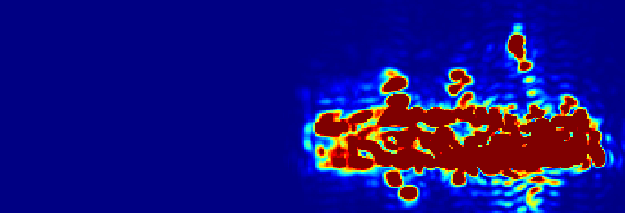
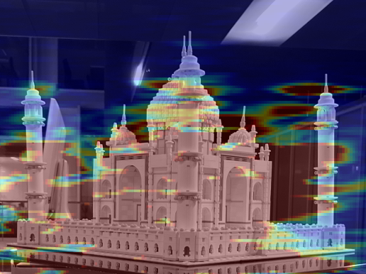
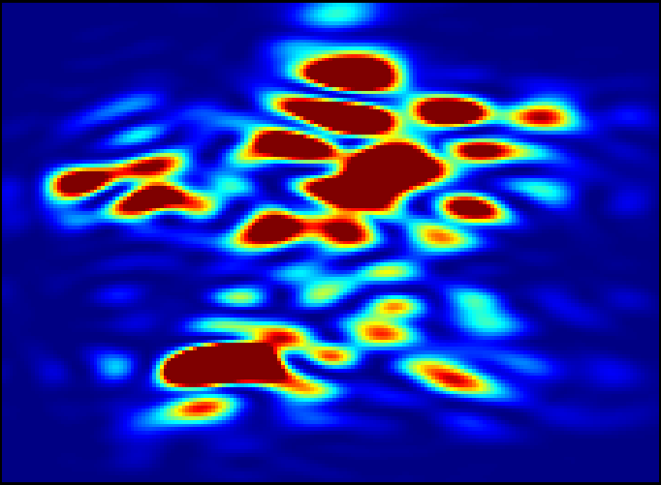





Complex Imaging Results
Composite Surfaces
(Door and Wall)
Concave Surface
(Computer Monitor)
Convex Surfaces
(Building Column)
Plane #1
Plane #2
RFlect

Slide 30

Qualitative Results: Concave Reflectors
Curved Computer Monitor
For the first time, RFlect enables high-accuracy imaging off concave surfaces

Slide 31

Qualitative Results: Convex Reflectors
Building Column
For the first time, RFlect enables high-accuracy imaging off convex surfaces

Slide 32


















Additional Results in the Paper

Slide 33
RFlect
First steps towards wireless around-the-corner imaging in practical environments
Introduce techniques for non-planar reflection imaging and precise reflector mapping
Demonstrates, for the first time, high-accuracy around-the-corner imaging off complex reflection geometries
Target
RFlect

Slide 34
RFlect
First steps towards wireless around-the-corner imaging in practical environments
Introduce techniques for non-planar reflection imaging and precise reflector mapping
Demonstrates, for the first time, high-accuracy around-the-corner imaging off complex reflection geometries
Target
RFlect

